Slide 1

Helping people in fuel poverty
For community workers and volunteers

Slide 2
About Saltley Community Association
Established 1972
Fuel poverty advice
Income maximisation
Energy saving practical help
Help with form filling
Cycling project
Hiking project

Slide 3


About Saltley Community Association
Shahid Mir
Safdar Mir

Slide 4
What we’re going to learn about
Signs and symptoms of fuel poverty | What can be done about condensation and damp? | Renewable energy measures
Health impacts of cold, damp homes | Understanding heating systems and controls
Running costs of appliances | Lighting
Understanding energy bills | Understanding energy meters including ppms and smart meters
Consumer rights - payment methods | How heat is lost from a home and the hierarchy
Consumer rights - debt and disconnection | Low cost energy saving actions
Consumer rights - what help is available to vulnerable people? | Long term energy saving actions

Slide 5
Introductions - why is everyone here?
What issues do you face?

Slide 6
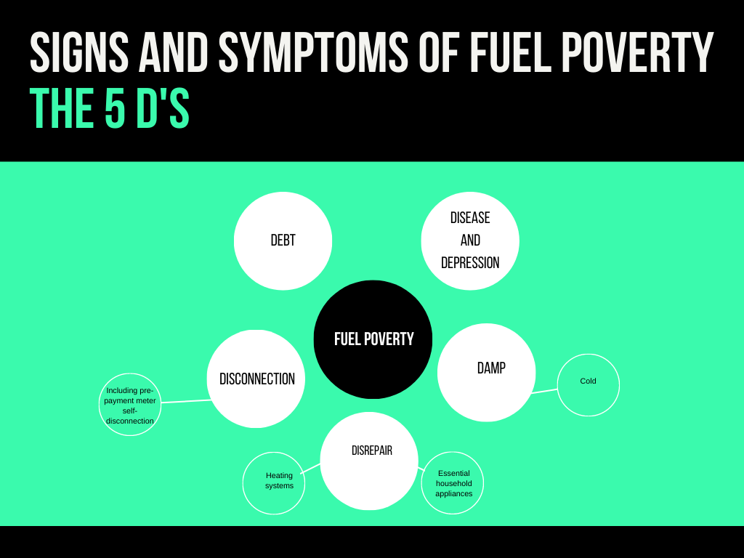

Slide 7
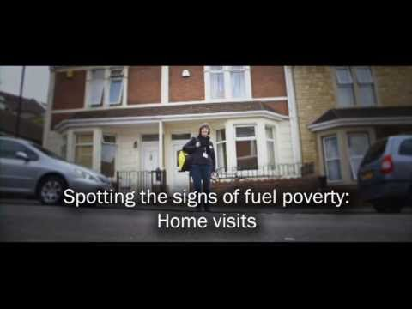

Slide 8
How many excess winter deaths in Birmingham?

Slide 9
How many excess winter deaths in Birmingham?
20-40,000 excess deaths each winter nationally due to cold and damp living conditions
Average 730 excess winter deaths in Birmingham

Slide 10
The causes and effects of fuel poverty
Solutions to fuel poverty
Energy efficiency improvements
Energy advice
Income maximisation
Tariff advice
Causes of fuel poverty
Inefficient buildings and appliances
Consumer behaviour
Low income
Tariff and payment method

Slide 11
Triggers to fuel poverty
Social
Childbirth
Bereavement
New medical condition
Domestic violence
Divorce/separation
Economic
Unemployment/redundancy
Insecure jobs
Universal Credit
Furlough

Slide 12
Which medical conditions are made worse by cold, damp homes?

Slide 13
Which medical conditions are made worse by cold, damp homes?
Circulatory conditions - heart disease, strokes, high blood pressure
Respiratory conditions - asthma, COPD
Musculoskeletal conditions - arthritis
Mental illness - anxiety, depression, SAD
Weakened immune system - ME, CFS, Sickle Cell Anaemia, Cancer

Slide 14
Understanding the running costs of household appliances
Zoom quiz …

Slide 15
Understanding the running costs of household appliances - answers
Answers …

Slide 16
Further help:
Mentoring
philip.beardmore@gmail.com
Emergency prepayment fuel vouchers
View slides first - https://energyconfidence.co.uk/8rh2
Referral form - https://forms.gle/pxp2bFZ2VTWhT9Sz5

Slide 17
Helping people in fuel poverty
For community workers and volunteers

Slide 18
This week ...
Understanding energy billing
Debt and disconnection
Priority Services for vulnerable people
Warm Home Discount

Slide 19
Understanding energy billing

Slide 20
What should be on an energy bill?

Slide 21
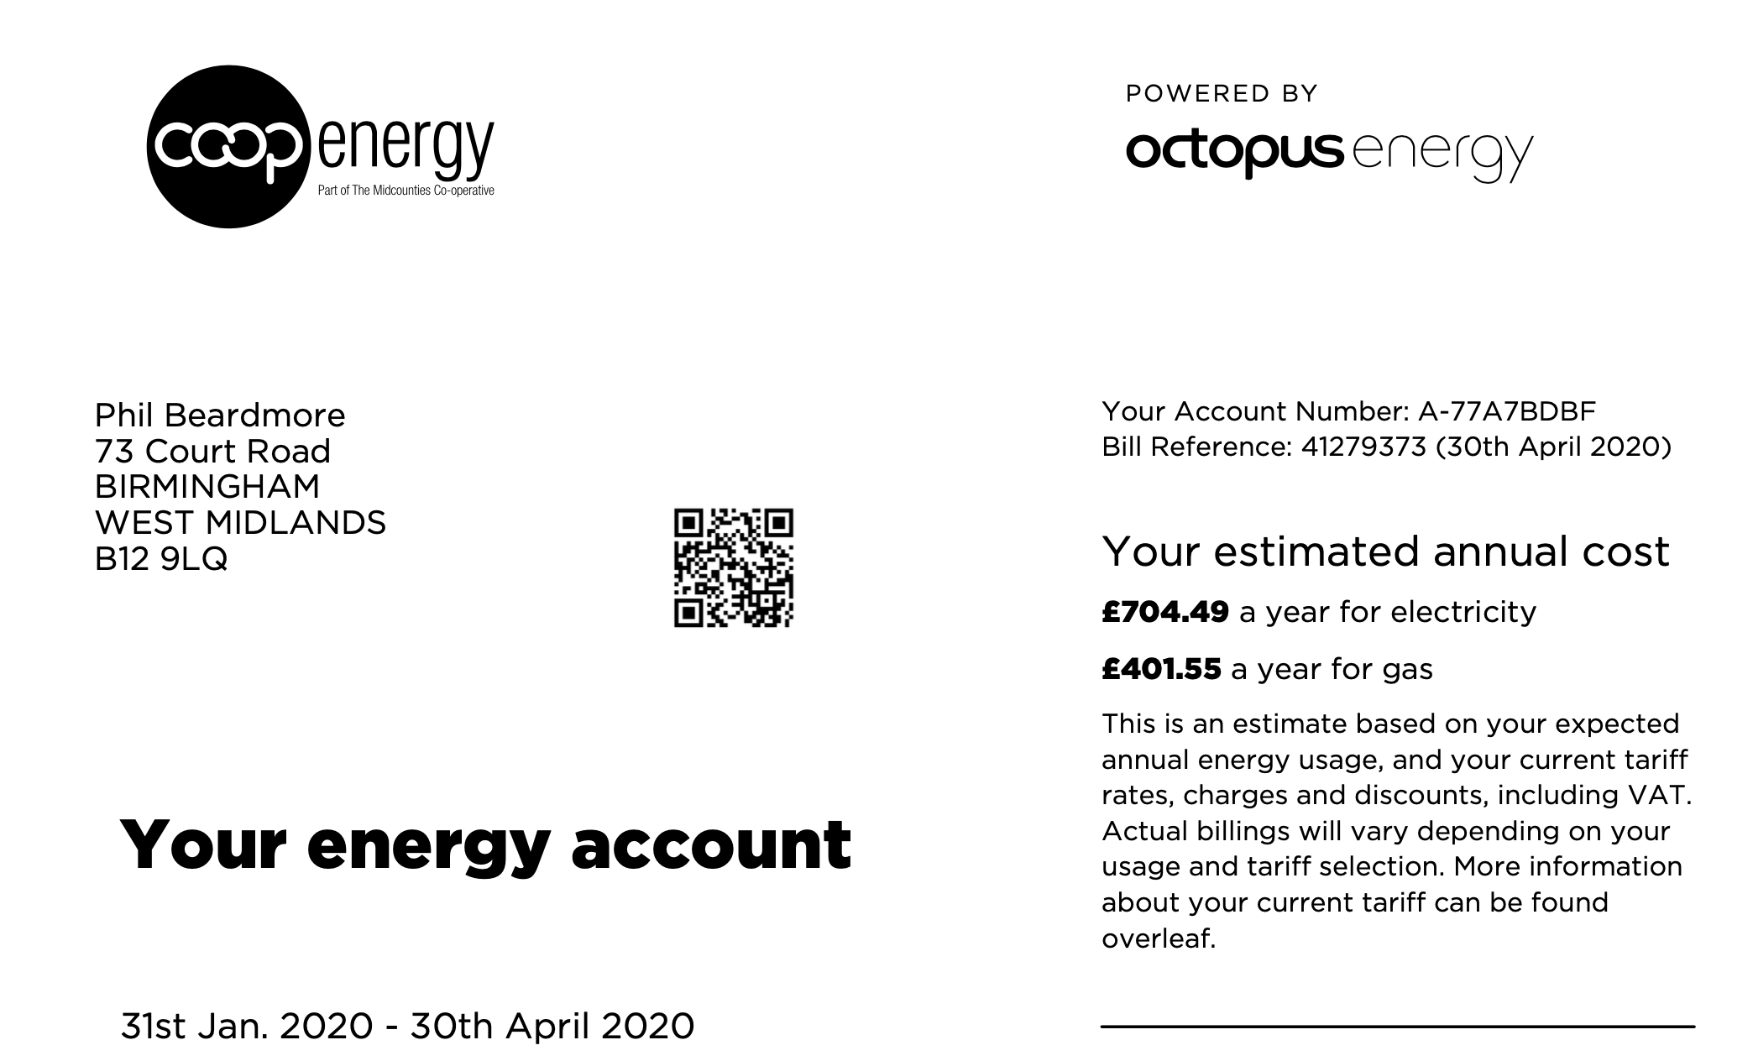
Name of supplier
Account number
Billing address
Date bill issued
ESTIMATED BILL
Estimated annual cost
Bill dates

Slide 22
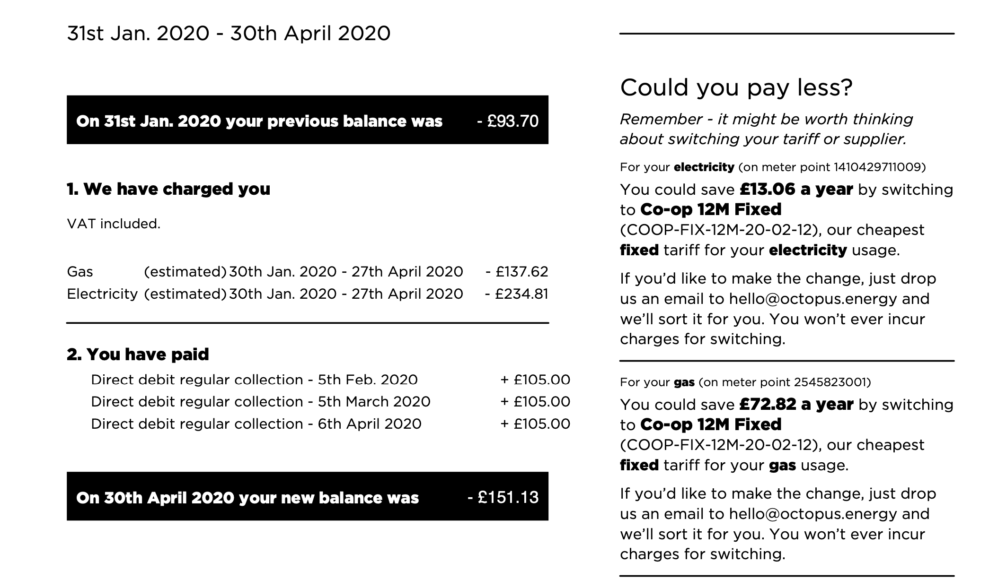
Are you on this supplier’s best tariff?
Breakdown of charges
Your payments
Account balance

Slide 23
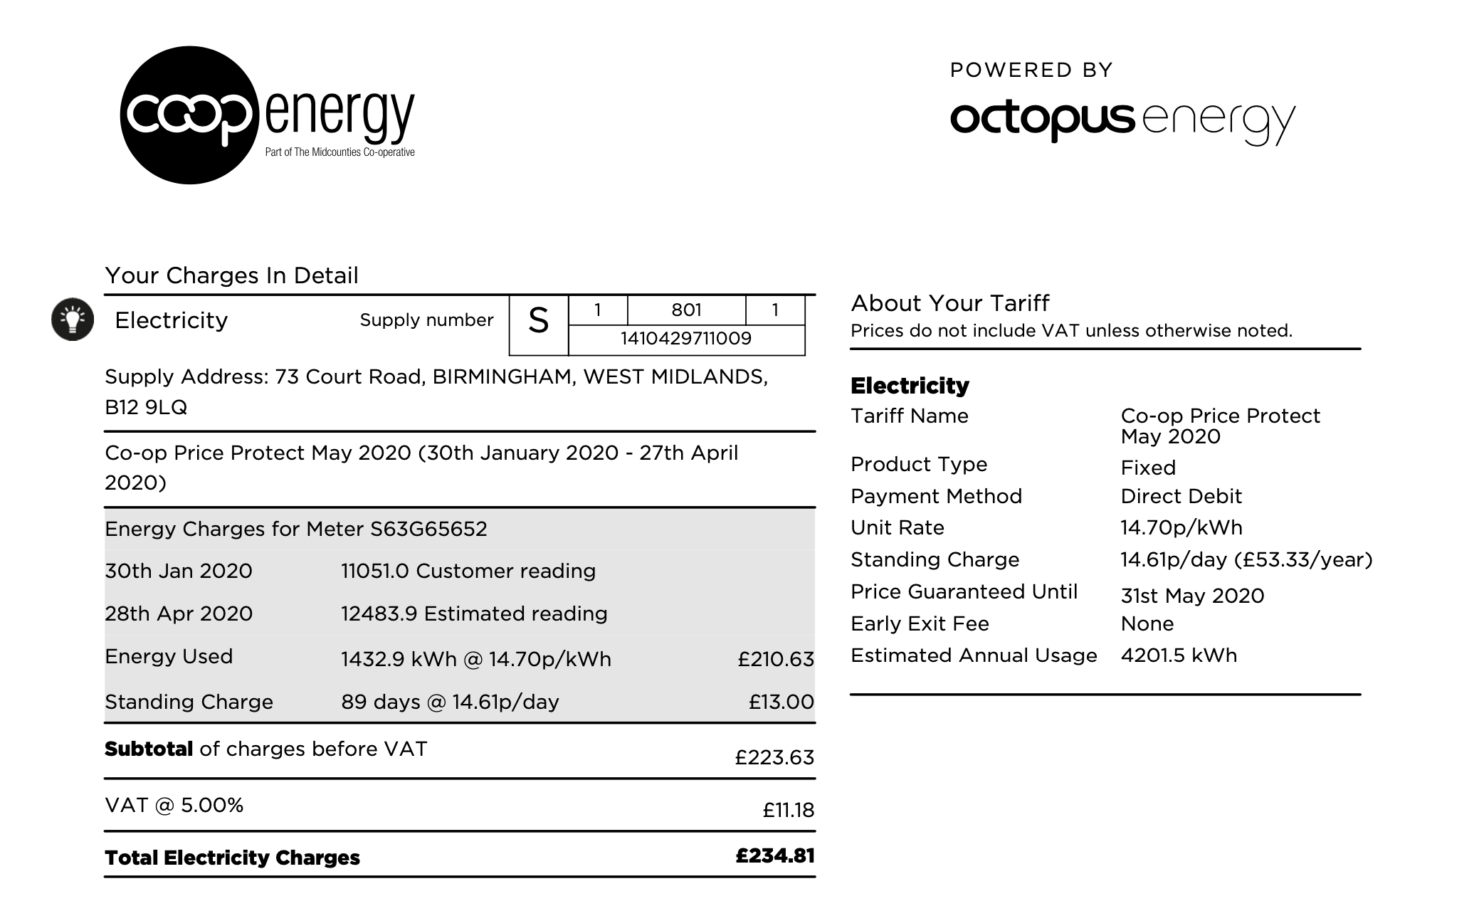
Supply number
Name and breakdown of tariff
Supply address
Meter serial number
Meter readings
Estimated annual use in kWh
Breakdown of electricity charges

Slide 24
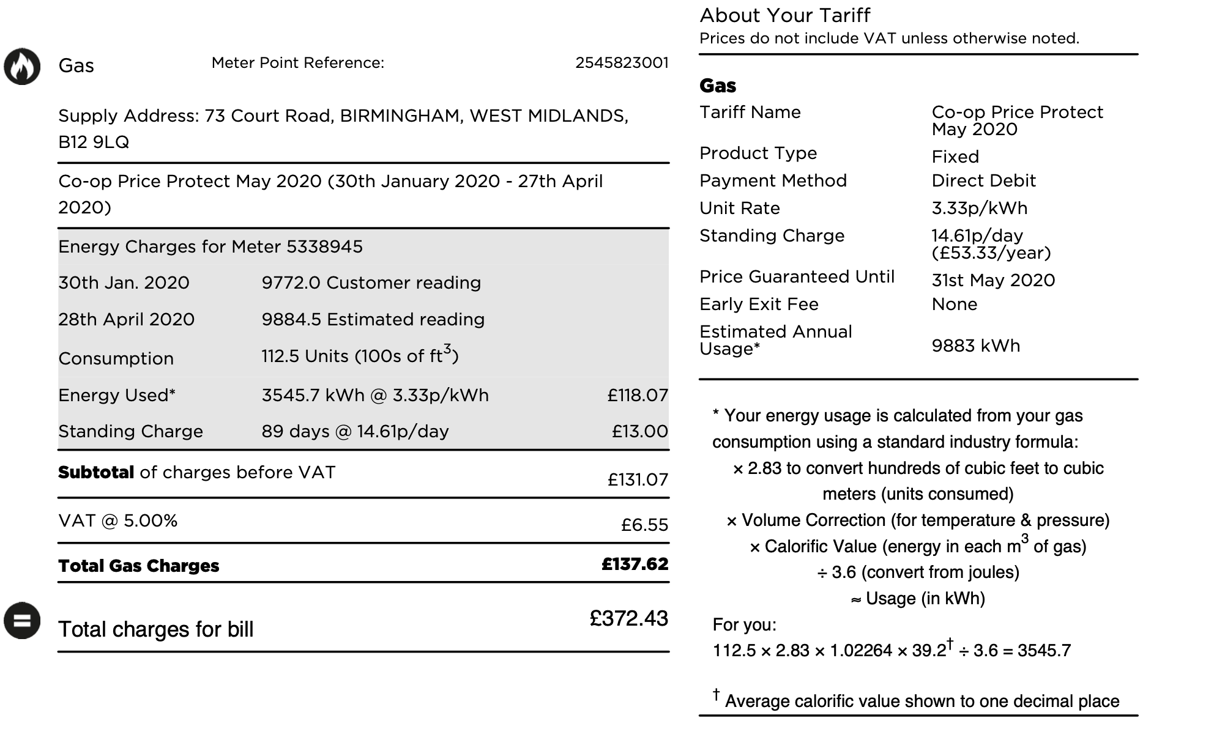
Meter point reference
Supply address
Name and breakdown of tariff
Meter serial number
Meter readings
Estimated annual use in kWh
Volume of gas - Hundreds of cubic feet OR cubic metres
Breakdown of gas charges
Conversion of volume of gas to kWh
Bill total

Slide 25
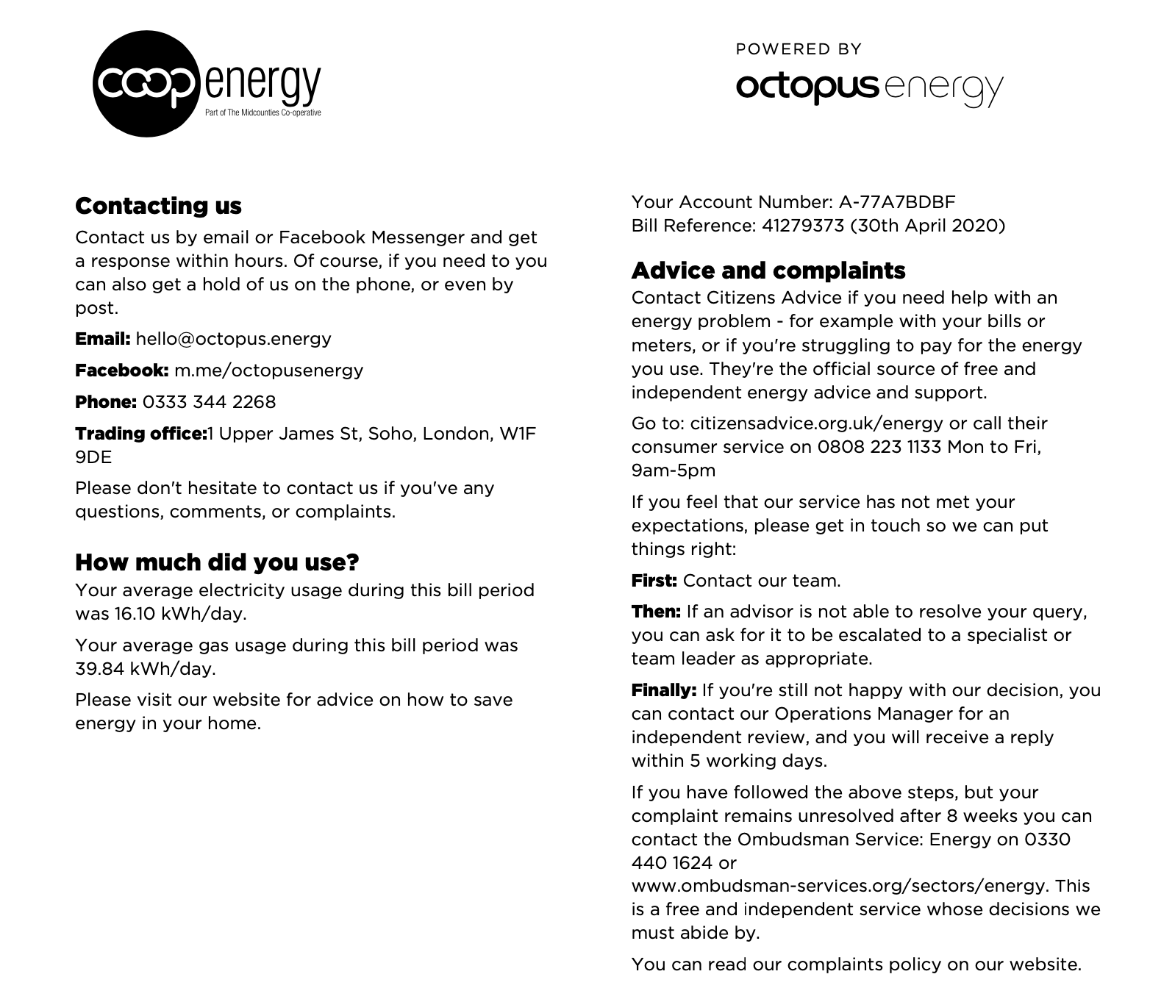
Contact information
How to complain
Daily average consumption
Where to get energy saving advice

Slide 26
Who is contractually responsible for paying the bill?
Contract – consumer has entered into a contract with a supplier
Person(s) named on the contract are jointly and severally liable, including shared dwellings
Deemed contract – consumer has not entered into a contract but is using fuel anyway
Any adult living in the property and using fuel can be held responsible

Slide 27
Who is contractually responsible for paying the bill?
Former tariff customer – has continued to be supplied by British Gas for gas, npower for electricity since before deregulation, has not entered into a contract
Any adult living in the property and using fuel can be held responsible

Slide 28
Energy contracts - exercise 1 - breakout rooms
In each of the scenarios below, who is responsible for paying the bill? All three scenarios are based on real life case studies.
Tiger, Brains, Spring and Scooper are students living in a shared house, which they rent privately. When they move in (September 2018), Brains agrees to contact the energy supplier to tell them there has been a change of occupancy. Brains puts their name on the bill.
The last bill was received in April 2019 and Brains collected the money from all four of them. The four of them move out in June 2019 and go their separate ways.
In July 2019, a bill arrives addressed to Brains. The landlord passes the bill on to Brains’ forwarding address. Brains has lost touch with the other three students and has no money because their student finance has run out. Brains’ dad phones the energy supplier and has a rant over the phone.
Who is contractually responsible for paying the bill in this instance?
What is the moral of this story?

Slide 29
Energy contracts - exercise 2 - breakout rooms
In each of the scenarios below, who is responsible for paying the bill? All three scenarios are based on real life case studies.
2. Ms X and her partner move into a house. They don’t get round to telling the energy supplier who they are.
The relationship between Ms X and her partner breaks up, and he moves out. She has no contact with him as he is abusive.
A large bill arrives in the name of the previous occupier.
Who is contractually responsible for paying the bill in this instance?
What would you do in these circumstances?

Slide 30
Energy contracts - exercise 3 - breakout rooms
In each of the scenarios below, who is responsible for paying the bill? All three scenarios are based on real life case studies.
3. Mrs X was widowed in 1990 and has continued to live in the same house ever since. She has always been supplied by British Gas for gas and npower for electricity because she doesn’t think she would be financially better off if she changed supplier. Mrs X lives with her adult son who has a learning difficulty and is not capable of managing his own financial affairs.
Sadly Mrs X passes away. Gas and electricity bills arrive addressed to Mrs X.
Who is responsible for paying the bill in this instance?
What would you do in these circumstances?

Slide 31
Who is my electricity supplier?
Contact the Meter Point Administration Service at Western Power Distribution - 0845 6030618
Give them the address and meter serial number
Make a note of the Meter Point Administration Number (MPAN)/Supply Number for future reference; the supplier name; and the date they started supplying

Slide 32
Who is my gas supplier?
You can use the following website:
https://www.findmysupplier.energy/
Contact the National Grid - 0870 608 1524
Give them the address and meter serial number
Make a note of the Meter Point Reference Number (MPRN) for future reference; the supplier name; and the date they started supplying

Slide 33
Independent gas transporters (IGT)
If the telephone helpline cannot identify property then it may be on an independent gas transporter network
The website is more likely to find the address if it’s an IGT
Independent gas transporter networks are most likely to be found on new housing estates
IGT MPRNs usually begin with 74 or 75
https://www.ofgem.gov.uk/gas/distribution-networks/connections-and-competition/independent-gas-transporters
IGT gas prices tend to be higher, price comparison services may not apply

Slide 34
Helping people in fuel poverty
For community workers and volunteers

Slide 35
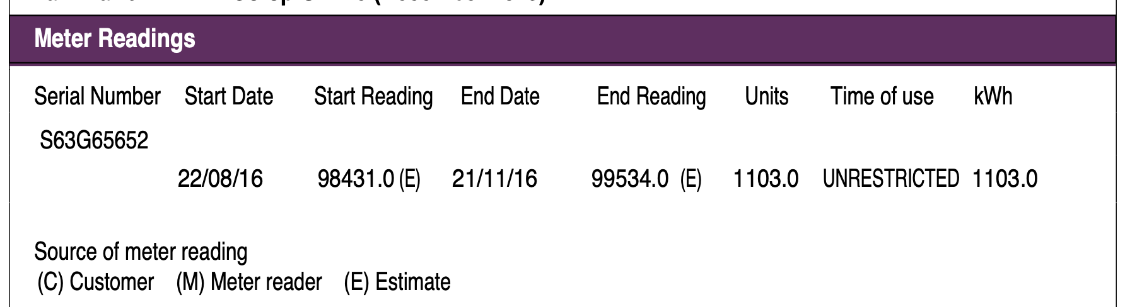
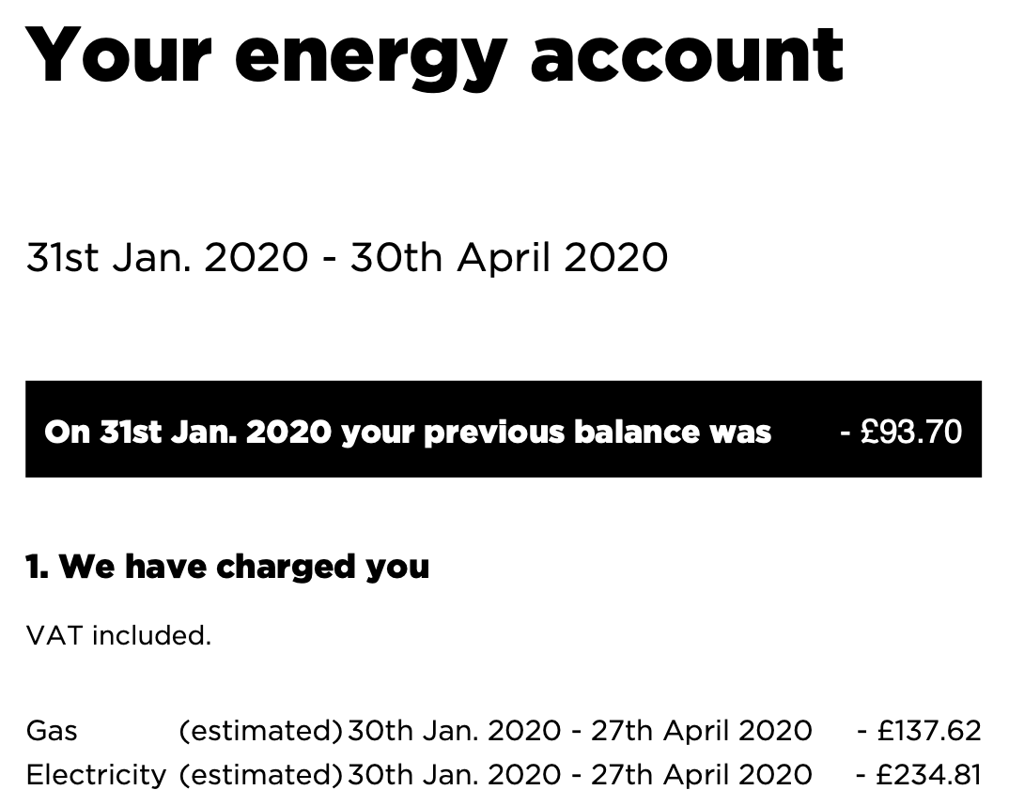
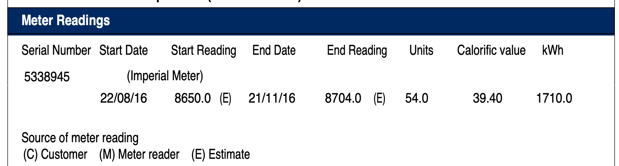
Estimated bills

Slide 36
Estimated bills
A series of underestimated bills will lead to a build-up of debt - back-billing
You cannot be back-billed for fuel used more than 12 months ago if you were incorrectly charged by the supplier
This does not apply if the householder has refused access to meter inspectors, or tampered with the meter.
The supplier should agree a payment arrangement on any remaining debt that you can’t settle straight away
https://www.citizensadvice.org.uk/consumer/template-letters/letters/energy/complain-to-a-supplier-about-back-billing/
Over-estimated bills lead to over-payment and you should get a refund

Slide 37
Payment methods
Suppliers are obliged to offer a range of payment methods to consumers
Including direct debit, payment on receipt of bill, monthly payment scheme, prepayment meters, Fuel Direct
British Gas have recently restricted payment options for their prepayment customers by withdrawing from PayPoint as a payment method

Slide 38
Fuel Direct
Consumer is in debt to supplier (£71+) and receives UC; income-based JSA; income-related ESA; IS; Pension Credit
Fuel Direct pays off debt and ongoing energy use
£3.70 per fuel is deducted pw for debt - or 5% of UC
If weekly energy use is £10 then payment is £13.70, deducted at source by DWP from benefits and paid to fuel supplier
Debt payment via FD and current consumption payment via PPM is also a possibility

Slide 39
Fuel Direct
FD is a payment method of last resort - usually accepted when a payment arrangement has been tried and failed
Apply to Jobcentre Plus or Pension Centre
Appeals Tribunal via Job Centre Plus
Usually when debt is paid off, consumer comes off FD, in certain circumstances they may be allowed to stay on
FD can’t be used to pay off debt to a previous supplier

Slide 40
Fuel Direct - information needed
Name of energy supplier and amount owed, customer reference number
National Insurance number
Current meter reading
Date of birth

Slide 41
Fuel Direct - advantages and disadvantages
Peace of mind
Prevents further build up of debt
Keeps people off PPMs
Potential to pay by DD when debt paid off
Prevent disconnection
Loss of control
Can discourage energy efficiency and build up of new debt
Need for accurate meter readings to prevent debt build-up
Best tariffs may not be available

Slide 42
Debt and disconnection - supplier obligations
Suppliers must make payment arrangements if a consumer is experiencing financial difficulties
Payment by instalments weekly, fortnightly, monthly
Inform the consumer of Fuel Direct if applicable
Offer to fit a PPM if safe and practical
Offer energy efficiency advice
Take into account money advice and recommendations from third parties

Slide 43
Debt and disconnection - consumer obligations
If charges are disputed, continue to pay what they think is the correct amount
It is advisable to take independent advice including preparing a personal budget
Disconnection is rarely used by suppliers for debt nowadays.

Slide 44
Disconnection - supplier obligations and voluntary codes
Prohibited from disconnecting a premises occupied by a customer who is eligible for the Priority Services Register 1 October - 31 March
The Energy UK “Safety Net” - a pledge to never knowingly disconnect a vulnerable household
You cannot be disconnected for debt owed to a former supplier
A bankrupt cannot be disconnected for debt built up before bankruptcy

Slide 45
Priority Services Register - who provides it
Gas and electricity suppliers
Gas transporters (network operators) - Cadent
Electricity distribution network operators - Western Power Distribution

Slide 46
Priority Services Register - eligibility
Of pensionable age, or
Have a disability (including impaired hearing or vision), or
Are chronically sick
Some suppliers also have families on benefits with a child under 5 on their PSR
Some of the benefits of the PSR have additional criteria

Slide 47
PSR - free annual gas safety check
Homeowner, and
Live alone, pensionable age or disabled or chronically sick
Live with others, and all occupants are pensionable age, disabled or chronically sick
Receive means tested benefits with a child under 5 (British Gas only)

Slide 48
PSR - other free services
Priority notice for electricity supply interruptions if you have essential medical equipment
Alternative arrangements if gas supply interrupted – alternative cooking and heating – also priority for reconnection - if everyone is on PSR
Password identification for supplier and transporter/distributor
Nominated bill receiver/payer
Alternative bill formats – large print, Braille, talking bill
Repositioning of emergency control valve

Slide 49
PSR - how to sign up
There is a data sharing agreement in place
This means if you contact your energy supplier, Cadent or Western Power Distribution, then you can be placed on all the relevant PSRs
Google “Cadent” or “WPD” or “name of energy supplier” plus “PSR”
Separate process for Severn Trent’s PSR

Slide 50

Warm Home Discount

Slide 51
Warm Home Discount
£140 discount on the electricity bill for qualifying households
Guarantee Credit element of Pension Credit - this is the WHD “Core Group” and automatically gets WHD credited to their bill
Your name or your partner’s is on the electricity bill
Your energy supplier must be part of the scheme - some smaller suppliers are not part of the scheme
If you have a pre-payment meter, the WHD is added as a credit to the meter

Slide 52
Warm Home Discount
Additionally, there is the “broader group” who qualify
Means-tested benefits
Suppliers have their own criteria
You or your representative must apply to the energy company
Smaller suppliers are not part of the scheme
If you change supplier at the wrong time you may no longer qualify
Many people miss out on it, and need help and encouragement to apply
There is also a Park Homes Warm Home Discount

Slide 53
Space and water heating systems
The law is quite weak on minimum heating standards
There is no statutory or legal requirement to provide room heating
Decent Homes Standard says socially rented homes must provide 'a reasonable degree of thermal comfort' but does not include a requirement for affordability

Slide 54
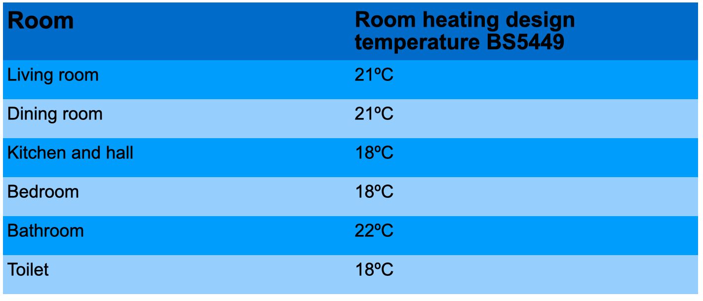
Room temperatures for wet central heating systems

Slide 55
Why room temperatures matter

Slide 56
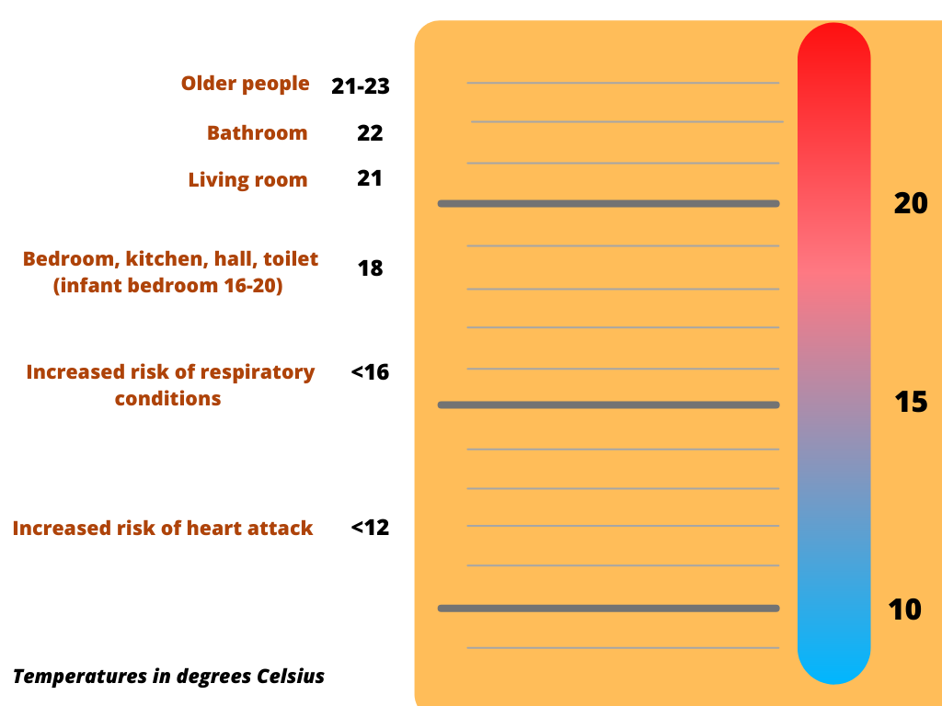

Slide 57
Further reading
https://assets.publishing.service.gov.uk/government/uploads/system/uploads/attachment_data/file/776497/Min_temp_threshold_for_homes_in_winter.pdf

Slide 58
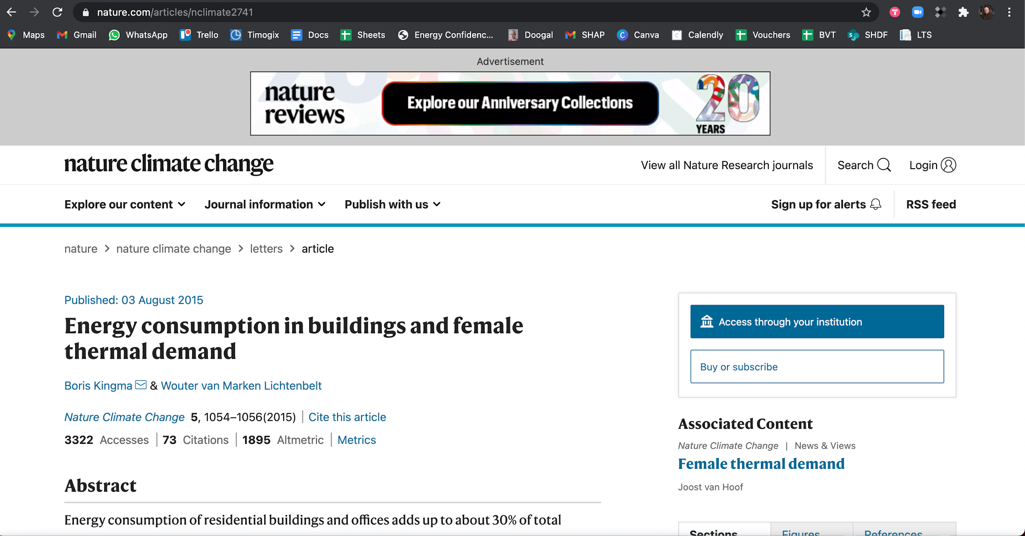

Slide 59
Wet central heating systems
Central boiler heats water
Hot water is distributed through pipes to heat exchangers in floors or walls, or usually through radiators
Mains gas is the most common fuel
Hot water can be used for washing instantaneously (combination boiler) or stored (system boiler with hot water cylinder)
Condensing boilers are most efficient. A condensing boiler can be a condensing combination boiler or a condensing system boiler.

Slide 60
Condensing gas boilers
Have a second heat exchanger that makes them more efficient than pre-2005 boilers
Can be Condensing Combination boilers (instantaneous hot water) or Condensing System/Conventional boilers (hot water stored in cylinder)
A condensate pipe is a good way to recognise a condensing boiler

Slide 61
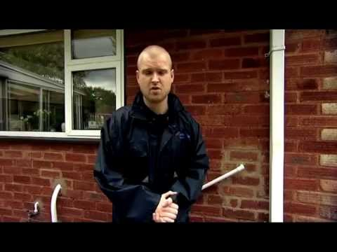

Slide 62
Warm air heating systems
A central unit warms air
Warm air is distributed by fans through ducts to outlet registers throughout the house
Filters remove dust particles
Electrostatic filters can be fitted to remove pollens
Mains gas is the most common fuel
Difficult to control and inefficient

Slide 63
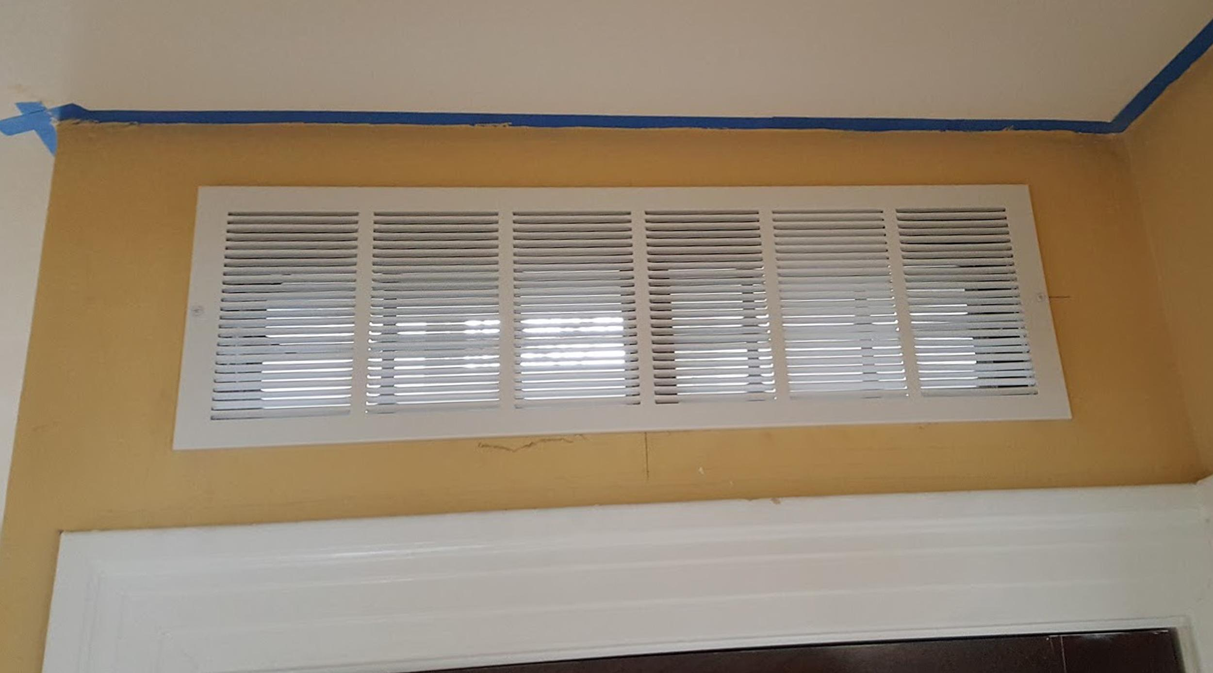
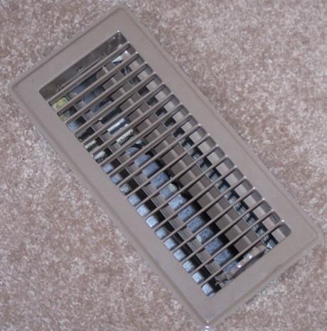
Images:
By Angelsharum - Own work, CC BY-SA 3.0, https://commons.wikimedia.org/w/index.php?curid=33132962
By Tim Evanson - https://www.flickr.com/photos/23165290@N00/25432805376/, CC BY-SA 2.0, https://commons.wikimedia.org/w/index.php?curid=47293036

Slide 64
Electric storage heating systems
Heat storing materials such as concrete, ceramics, oil, water are heated up during off-peak periods such as night-time
The heat is stored to be released during the following day
The age of the appliances, the sophistication of its controls, the heat storage properties of the heat storing material all affect the efficiency of the heating system

Slide 65
Electric under-floor heating systems
Electric elements placed within the concrete floor slabs heat the floor during off-peak periods
Heat is then released from the slab
There is little control over the heating system
Common in 1960s in high-rise buildings
Best suited to modern, highly insulated properties where constant heat output is required

Slide 66
Portable individual heaters
Fuels include bottled gas, electricity, paraffin, heating oil
Bottled gas and paraffin often banned by social housing providers through tenancy agreement
Risk of trips and falls
Carbon monoxide and condensation risks from bottled gas, paraffin, heating oil due to ventilation issues

Slide 67
Community/district heating systems
Combined heat and power – efficient way of producing electricity, heat and hot water – fuelled by gas or biomass
Very widespread in many parts of Europe and beyond
Quite rare in the UK, occasionally found in tower blocks and other high-density housing, more commonly found in hospitals, factories, universities
Micro-CHP systems are now available

Slide 68
Air source and ground source heat pumps
Should only be used in a well insulated building
People need to be shown how they work
A secondary source of domestic hot water may be needed e.g. immersion heater, in which case people need to be shown how to control the immersion heater

Slide 69
Heating appliance and system controls
Time switches and programmers
Air temperature thermostats
Thermostatic radiator valves
Hot water cylinder thermostat
Input/output charge controls (storage heaters)
When did you last adjust yours?

Slide 70
Timers, programmers and timer/programmers
Clock-based units that control when space and water heating system switches on and off
Mechanical or digital
On and Off periods, which may be repeated over a 24 hour or 7 day cycle
Have 'override' or 'advance' options so system can be used outside of times that the system is programmed to operate

Slide 71
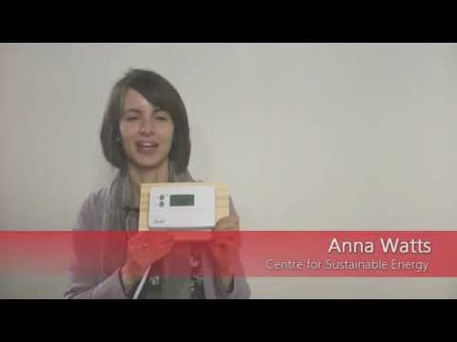

Slide 72
Helping people in fuel poverty
For community workers and volunteers

Slide 73
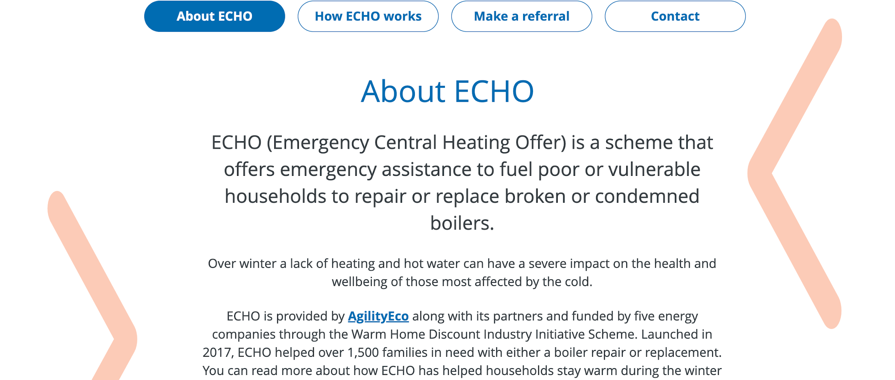
www.emergencyheating.org.uk

Slide 74
Air temperature thermostats
Also known as room thermostats
Sense and react to room air temperature
Regulate the heat output from the appliance or system to maintain the desired temperature setting
Location of air temperature thermostat is an important part of the design of a heating system – regularly heated area with free circulation, not exposed to draughts, away from internal heat sources and direct sunlight, accessible

Slide 75
Thermostatic Radiator Valves
Fitted to radiators on wet central heating systems
React to room temperature and adjust heat output from radiator
TRVs can be adjusted to desired setting
Within overall limits of main controls (programmer and air temperature thermostat), TRVs allow different rooms to be controlled to different temperatures

Slide 76
Smart heating controls
Include the functions of a timer/programmer; room thermostat; thermostatic radiator valves
Can be controlled from a smart phone
Some types use artificial intelligence to get to know your lifestyle and predict when to heat the home
Manual override
Cost is coming down

Slide 77
Hot water cylinder temperature control thermostat
Control temperature of water in hot water tank
Can be adjusted manually
Mechanical or electronic
See manufacturer’s instructions for recommended temperature for storing hot water

Slide 78
A case study

Slide 79
Night storage heaters - input/output charge controls
Input charge controls allow the householder to adjust the off-peak electricity input rate, after considering how much heat they will need the following day
Some heaters have temperature sensors that automatically adjust the input rate in response to outside temperatures
Output controls regulate the heat output from the appliance

Slide 80
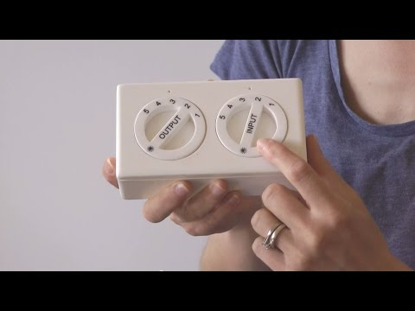

Slide 81
Heating controls case study - Diane
Diane is a community worker on an estate where most people have night storage heaters and complained about being cold
Diane learned about the correct use of storage heater charge and discharge controls
She posted on the neighbourhood Facebook group
Dozens of people followed this advice, and posted that their homes were warm for the first time they could remember

Slide 82
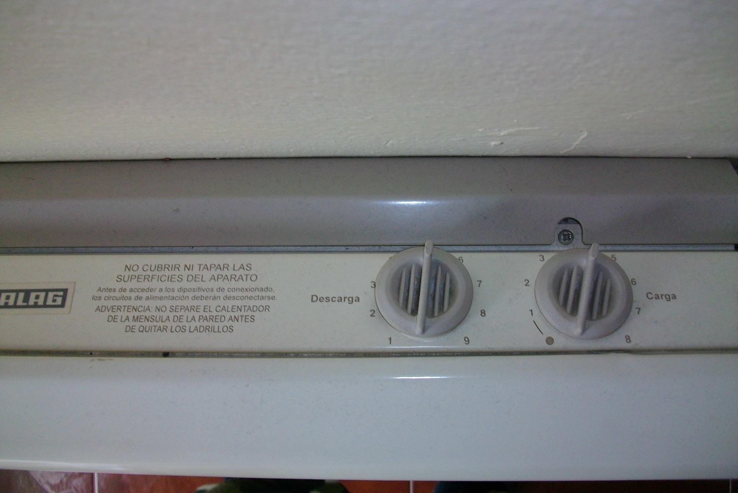
Quiz - where in the world would you find these heating controls?

Slide 83
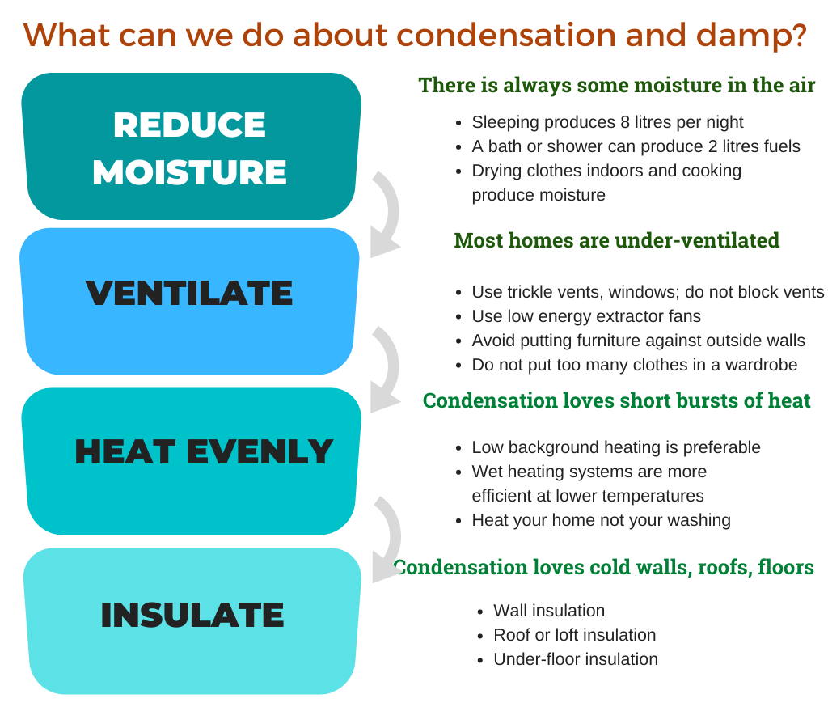

Slide 84


Slide 85
Other forms of damp
Rising damp - caused by rising groundwater
Penetrating damp - infiltration by water from outside the home

Slide 86
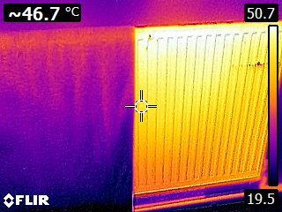
Insulation is for walls, roofs and floors; not for radiators

Slide 87
Condensation and damp case study - Carla
Carla had a problem with condensation and damp in bedrooms and bathrooms - 3 bed semi with one adult and one child
Heating regime - central heating was on for two hours, then off for two hours
Carla mentioned this to her neighbour, Lilith
Lilith “I used to have that problem. Then someone advised me to have a low background heat instead of short bursts of on/off heat. Now I don’t have the problem of condensation and damp any more”.
Carla adjusted her heating to a low background heat - 18 degrees during the day, 16.5 degrees at night
Carla now reports much less condensation and damp
Carla is also planning to increase the ventilation in the home

Slide 88
Choosing a tariff and supplier
When did you last check if you were on the best available energy tariff?
Can your existing supplier offer you a better deal?
Can a price comparison site offer you a better deal?

Slide 89
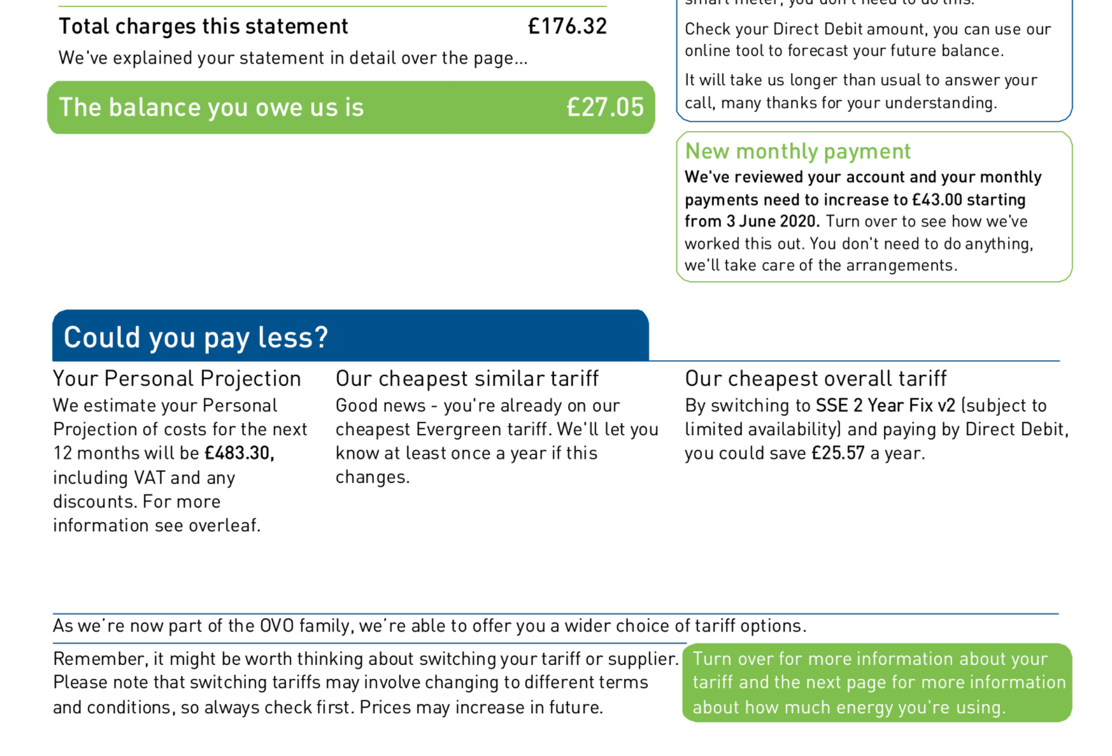

Slide 90
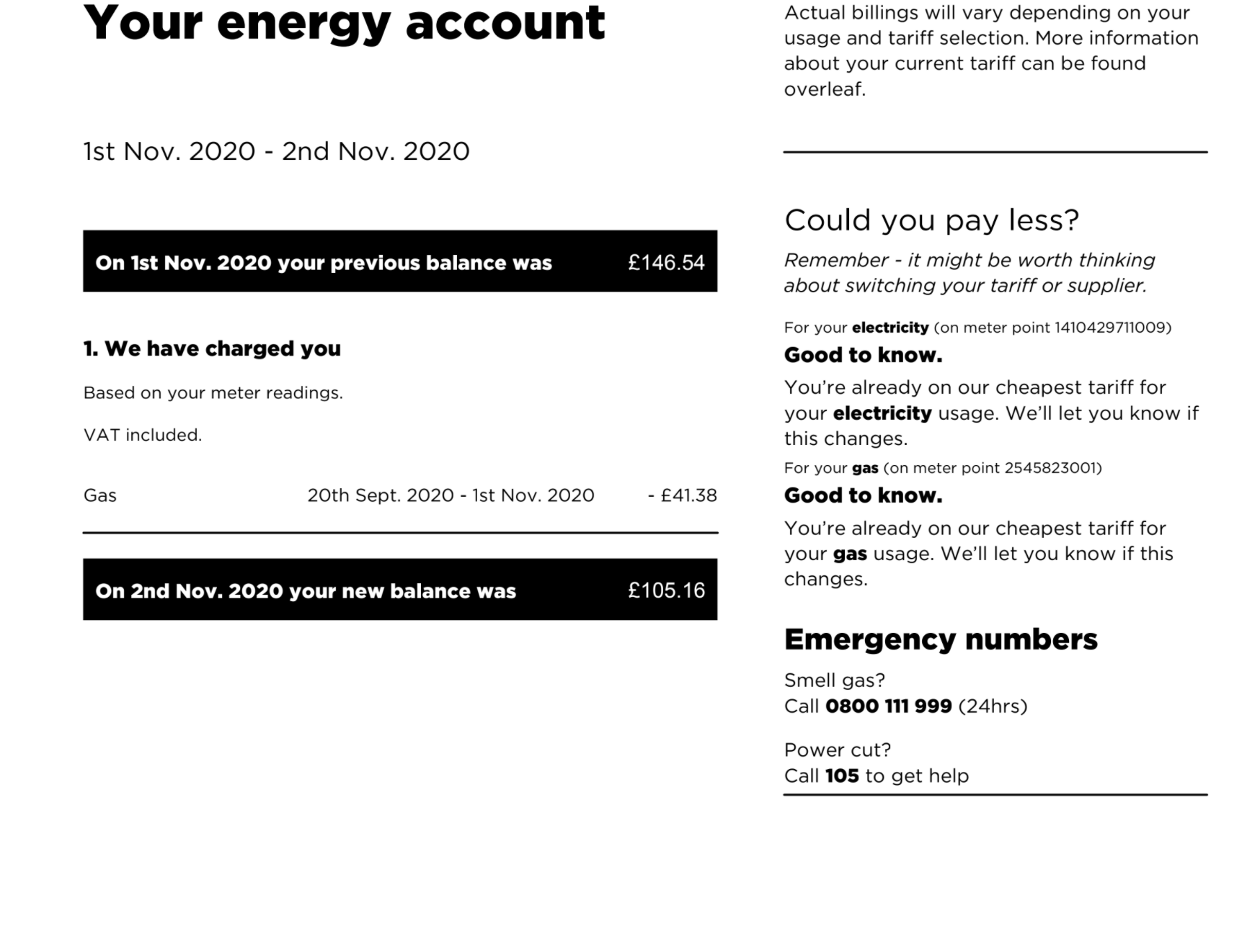

Slide 91
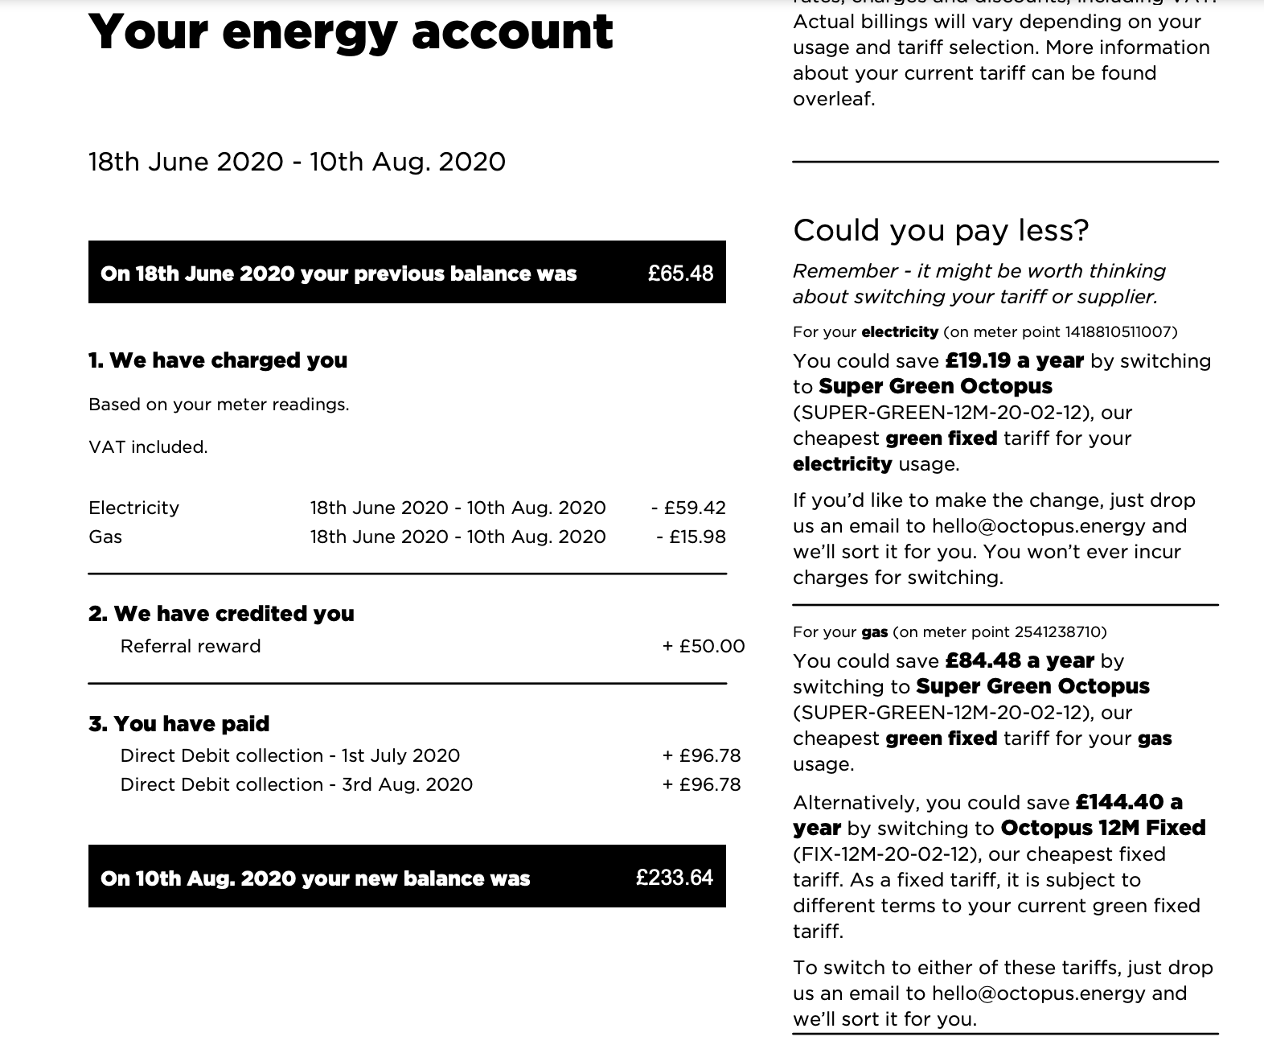

Slide 92
Helping people in fuel poverty
For community workers and volunteers

Slide 93
Week 5
Prepayment meter issues
Smart meter issues for the fuel poor
The energy saving hierarchy
Practical energy saving measures

Slide 94
Prepayment meters
Usually the most expensive method
Least convenient method
Location and opening times of payment point are important
Helps to avoid debt
Risk of self-disconnection

Slide 95
Prepayment meters and debt
Can be used to collect debt
On some tariffs, still take a standing charge even if you don't use fuel
Limited emergency credit facility
When putting credit onto the meter, it will take debt, accumulated standing charge and emergency credit repayment before it allows fuel consumption

Slide 96
Prepayment meters - common issues
Difficult to understand and no paper statements
Failure to reset meter on change of occupier or change of supplier leading to incorrect tariff, debt
Loss of smartcard/key, self-disconnection
Charging outlet availability vs internet top-up
Misconception that you can't choose supplier – you can change supplier with PPM debt of up to £500

Slide 97
Prepayment meters - common issues
Misconception that you can't choose payment method – sometimes tied to renting – this is false
Two-tier tariffs use credit faster when you first charge the meter
Delay in calibrating meter to reflect price changes can lead to debt

Slide 98
Prepayment meters - change of supplier issues
Loss of supply on transfer if there is an error in identifying the Meter Point Reference Number (gas) or Meter Point Administration Number (electricity)
Potential loss of supply if new supplier fails to send payment card/key, or
Payments being allocated to the wrong account/ supplier
This means that a level of hand-holding is necessary for vulnerable PPM users changing supplier

Slide 99
Smart meters - who has one?

Slide 100
Smart meters - what they can and can’t do

Slide 101
Smart meters - what they can and can’t do
CAN
End estimated bills
Change tariff / supplier easier
Understand running costs of appliances
Time of use tariffs
Remote top-up of prepayment meter
Connect to smart heating controls
Be controlled through a smart phone
CAN’T
Reduce household fuel bills
Give you free electricity
Breach your data protection rights
Increase your household’s broadband bill
Increase household fuel bills

Slide 102
Smart meters - case study
Mr B made appointment for smart meter
Engineer turned up and said could not do it as transformer belonging to WPD needed to be replaced; engineer raised job with WPD on his phone
Mr B never heard from WPD
Mr B’s energy supplier underwent a transfer of engagements to a new supplier
Made appointment with new supplier for smart meter and informed them of the problem
Engineer turned up and said he could not do it as the transformer belonging to WPD needed to be replaced; engineer raised job with WPD on his phone
WPD have been to change the transformer
Mr B has not heard from his energy supplier when they are going to install the smart meter

Slide 103
Smart meters - issues for the fuel poor
Unfamiliar language
Cognitive skills
Meter ownership in some kinds of accommodation
Gas safety
Misconceptions
Interoperability
Discalculia
Unrealistic expectations
Lack of space for smart meters
Awareness of spend exacerbates fear of debt
Change of tenancy issues - disappearance of in-home display
Failure of smart meter to communicate with supplier

Slide 104
Meter tampering and bypassing the meter
Meters are becoming more tamper-proof
However theft of gas and electricity is becoming more widespread due to DIY Dark Web guides, and organised crime offering it as a service to households
Theft of Gas and Abstraction of Electricity are criminal offences;
Debt cannot be recovered by the energy supplier by civil means; they must apply to a Magistrate to prove and enforce collection of debt arising from theft or abstraction
Nevertheless, it is widespread for some energy suppliers to accuse low-income householders of meter tampering and to recover costs without applying to a Magistrate
If a household is accused of meter tampering then it is a criminal matter; you can advise them of their rights but what they need is a solicitor.

Slide 105

How heat is lost through a home - quiz

Slide 106
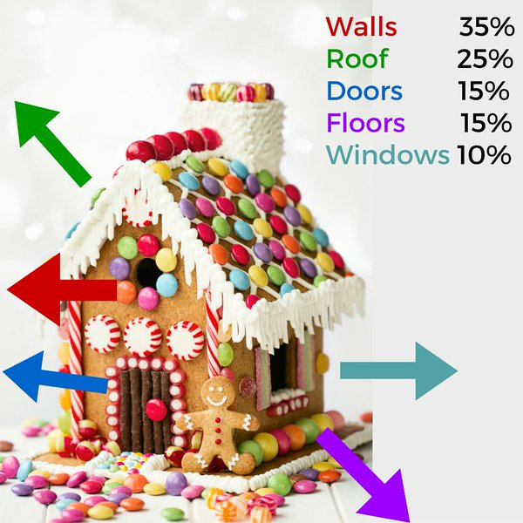
How heat is lost through a home

Slide 107
Heat loss depends on:
The properties of the building element:
Thermal conductivity - the rate at which a building element will allow heat to pass through it
Surface area of element - how big an area it has for heat to transfer through
This is why more heat is lost through walls, roofs and floors, than through windows and doors. The surface area of a typical home is 80% walls and 20% windows.
Thermal bridges - pathway of low/missing insulation or high conduction - e.g. where building components with different thermal properties meet

Slide 108
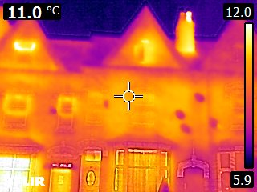
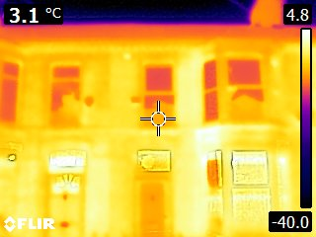
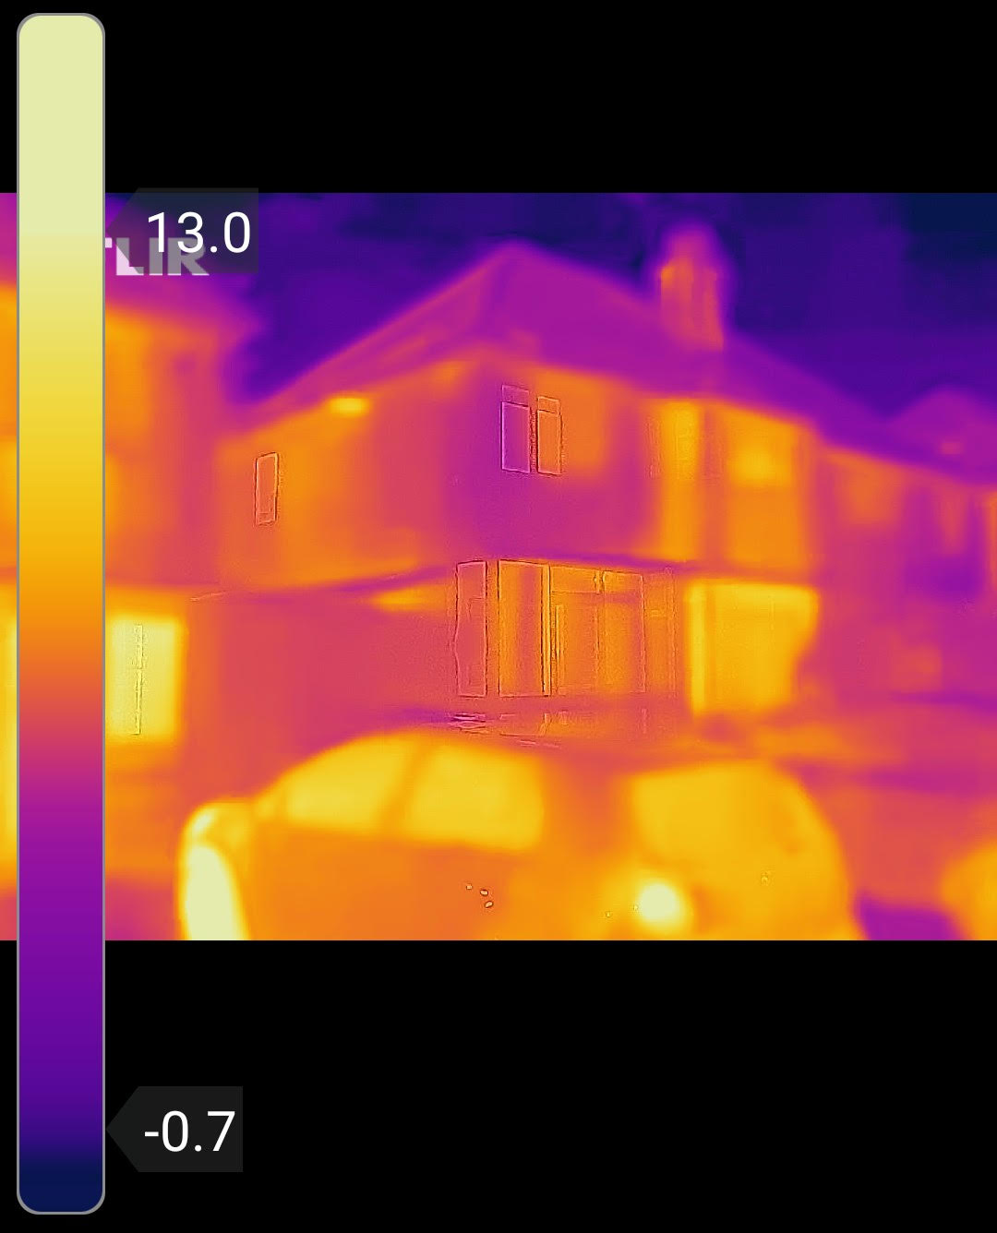
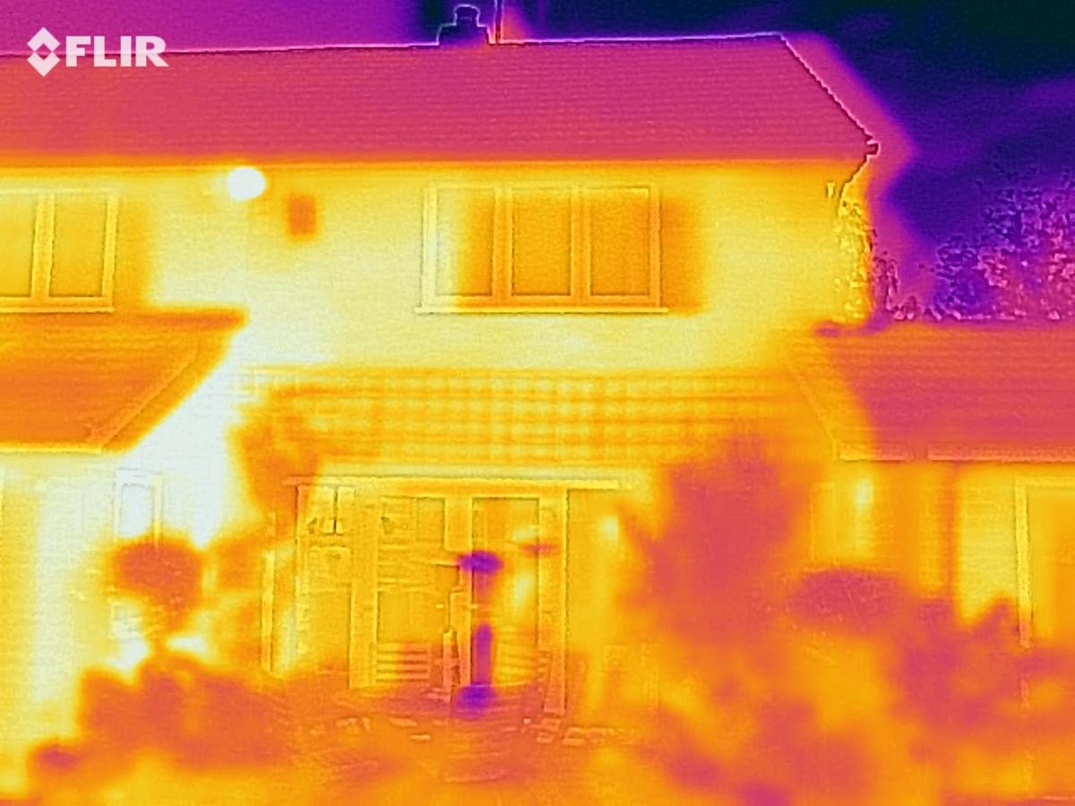
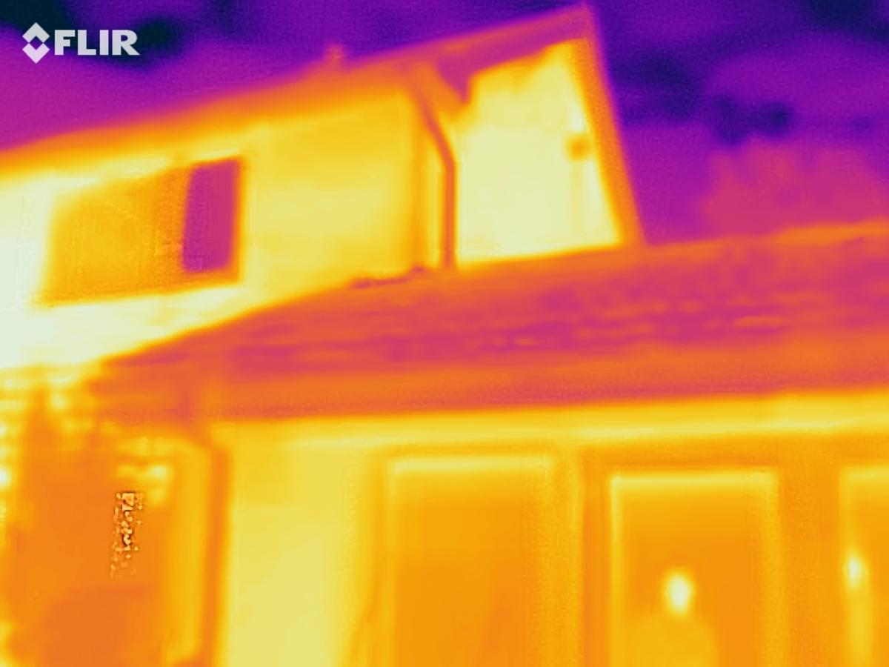

Slide 109
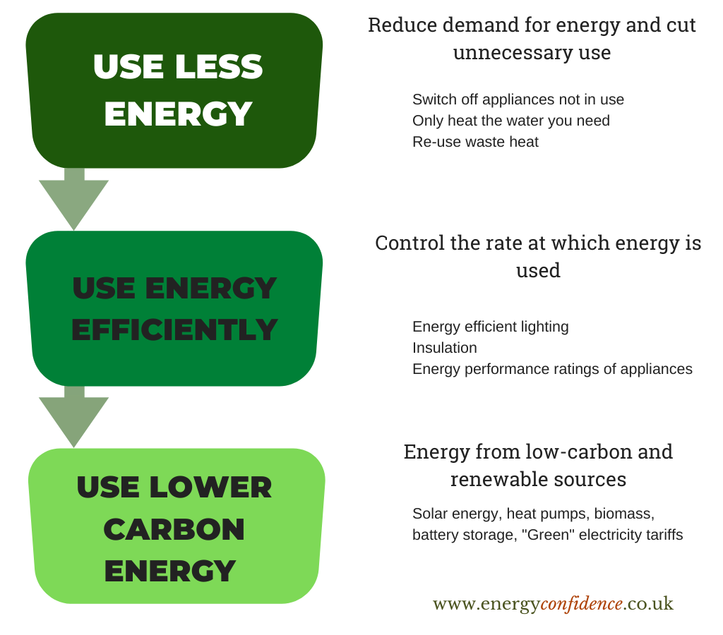
The energy saving hierarchy

Slide 110
Energy hierarchy quiz
Zoom polls

Slide 111
Energy hierarchy quiz … answers
Switch off appliances when not in use - USE LESS ENERGY
Energy efficient lighting - USE ENERGY EFFICIENTLY
Solar energy - LOWER CARBON ENERGY
Only heat the water you need - USE LESS ENERGY
Insulate a building -USE ENERGY EFFICIENTLY
Heat pumps - LOWER CARBON ENERGY
Energy performance ratings of appliances - USE ENERGY EFFICIENTLY
Re-use waste heat from showers - USE LESS ENERGY
Biomass - USE LOWER CARBON ENERGY
Smart heating controls - USE ENERGY EFFICIENTLY
Wind power - USE LOWER CARBON ENERGY
Battery storage of solar energy - USE LOWER CARBON ENERGY
Smart lighting controls - USE ENERGY EFFICIENTLY
“Green” electricity tariffs - LOWER CARBON ENERGY

Slide 112
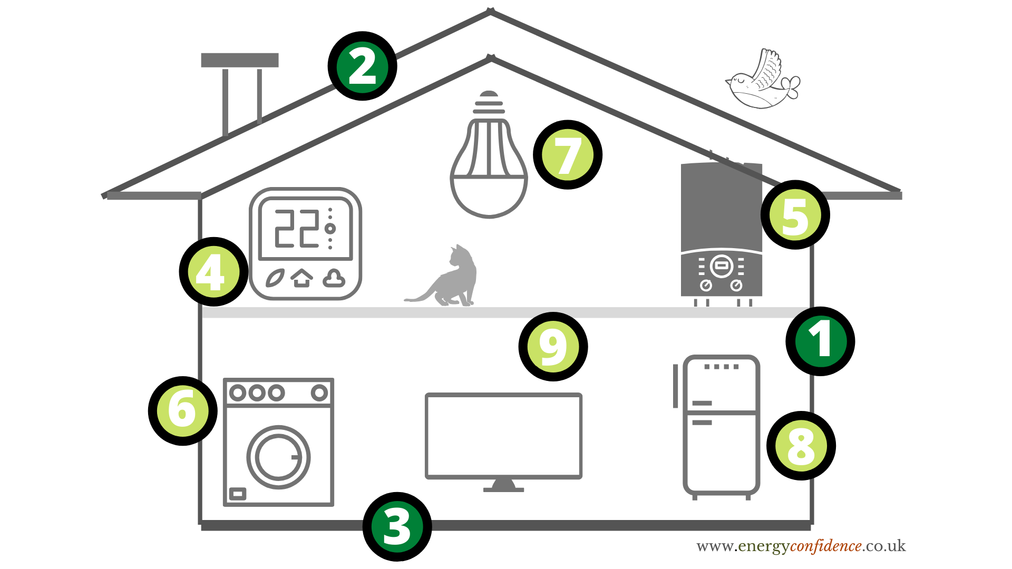
ZERO- OR LOW- COST ACTIONS
MEDIUM/HIGH-COST ACTIONS
4. Use heating controls
5. Use hot water controls
6. Washing machine temperature and full load
7. LED light bulbs
8. Defrost fridge
9. Turn things off
Insulate walls
Insulate roof
Insulate under floor
5. More
Efficient
Heating

Slide 113

Smart heating controls

Slide 114
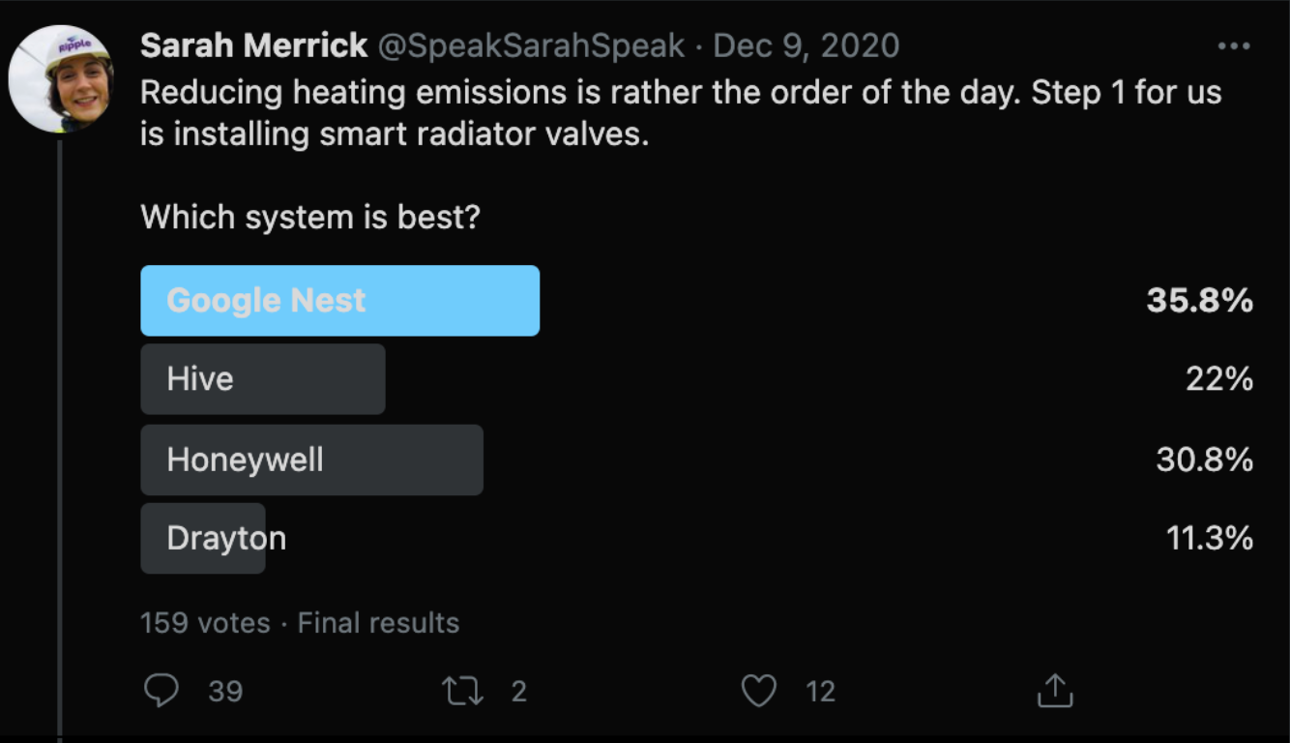
An informal poll of owners of smart radiator valves on Twitter in December 2020 gave the following results
Smart heating controls

Slide 115
What percentage of people do this ...

Slide 116
What percentage of people do this … answers
Do you have LED lighting in the whole house - 20% yes;
Do you have a smart meter - 33.5% yes;
When using the kettle, do you only boil the amount you need 78.1% yes;
Do you have one or more phone/laptop/tablet on charge overnight - 74.2% yes.

Slide 117
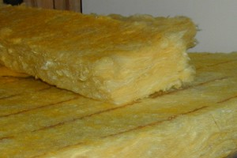
Loft insulation
https://pl.wikipedia.org/wiki/User:Radomil

Slide 118
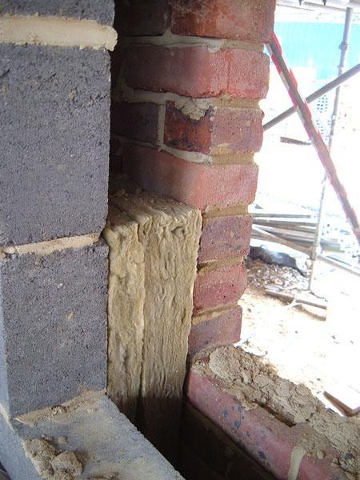
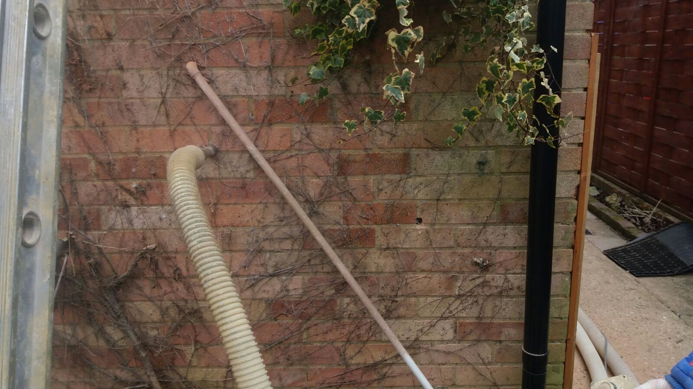
Cavity wall insulation
- as built
Cavity wall insulation
- retrofit
https://en.wikipedia.org/wiki/user:Mok9
https://commons.wikimedia.org/w/index.php?title=User:Workworkwembley

Slide 119

Traditional - Solid wall brick pattern
http://freestocktextures.com/texture/id/690

Slide 120
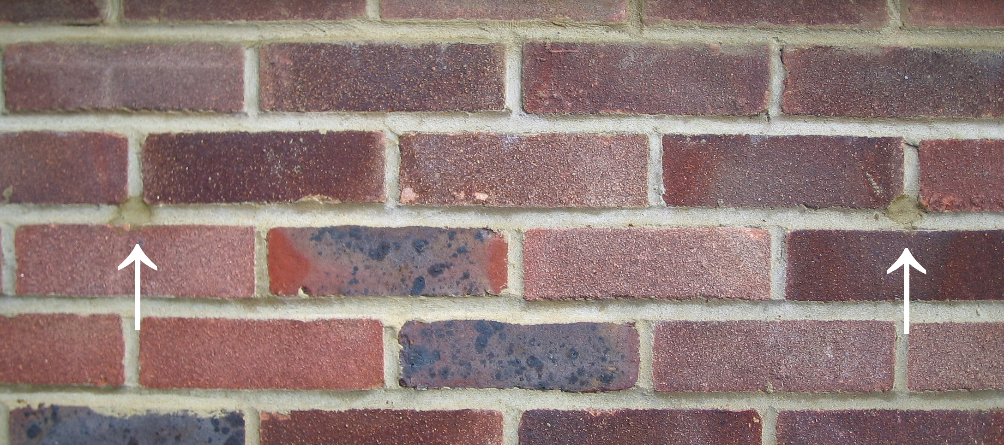
Traditional - Cavity wall brick pattern (with insulation drill holes)

Slide 121
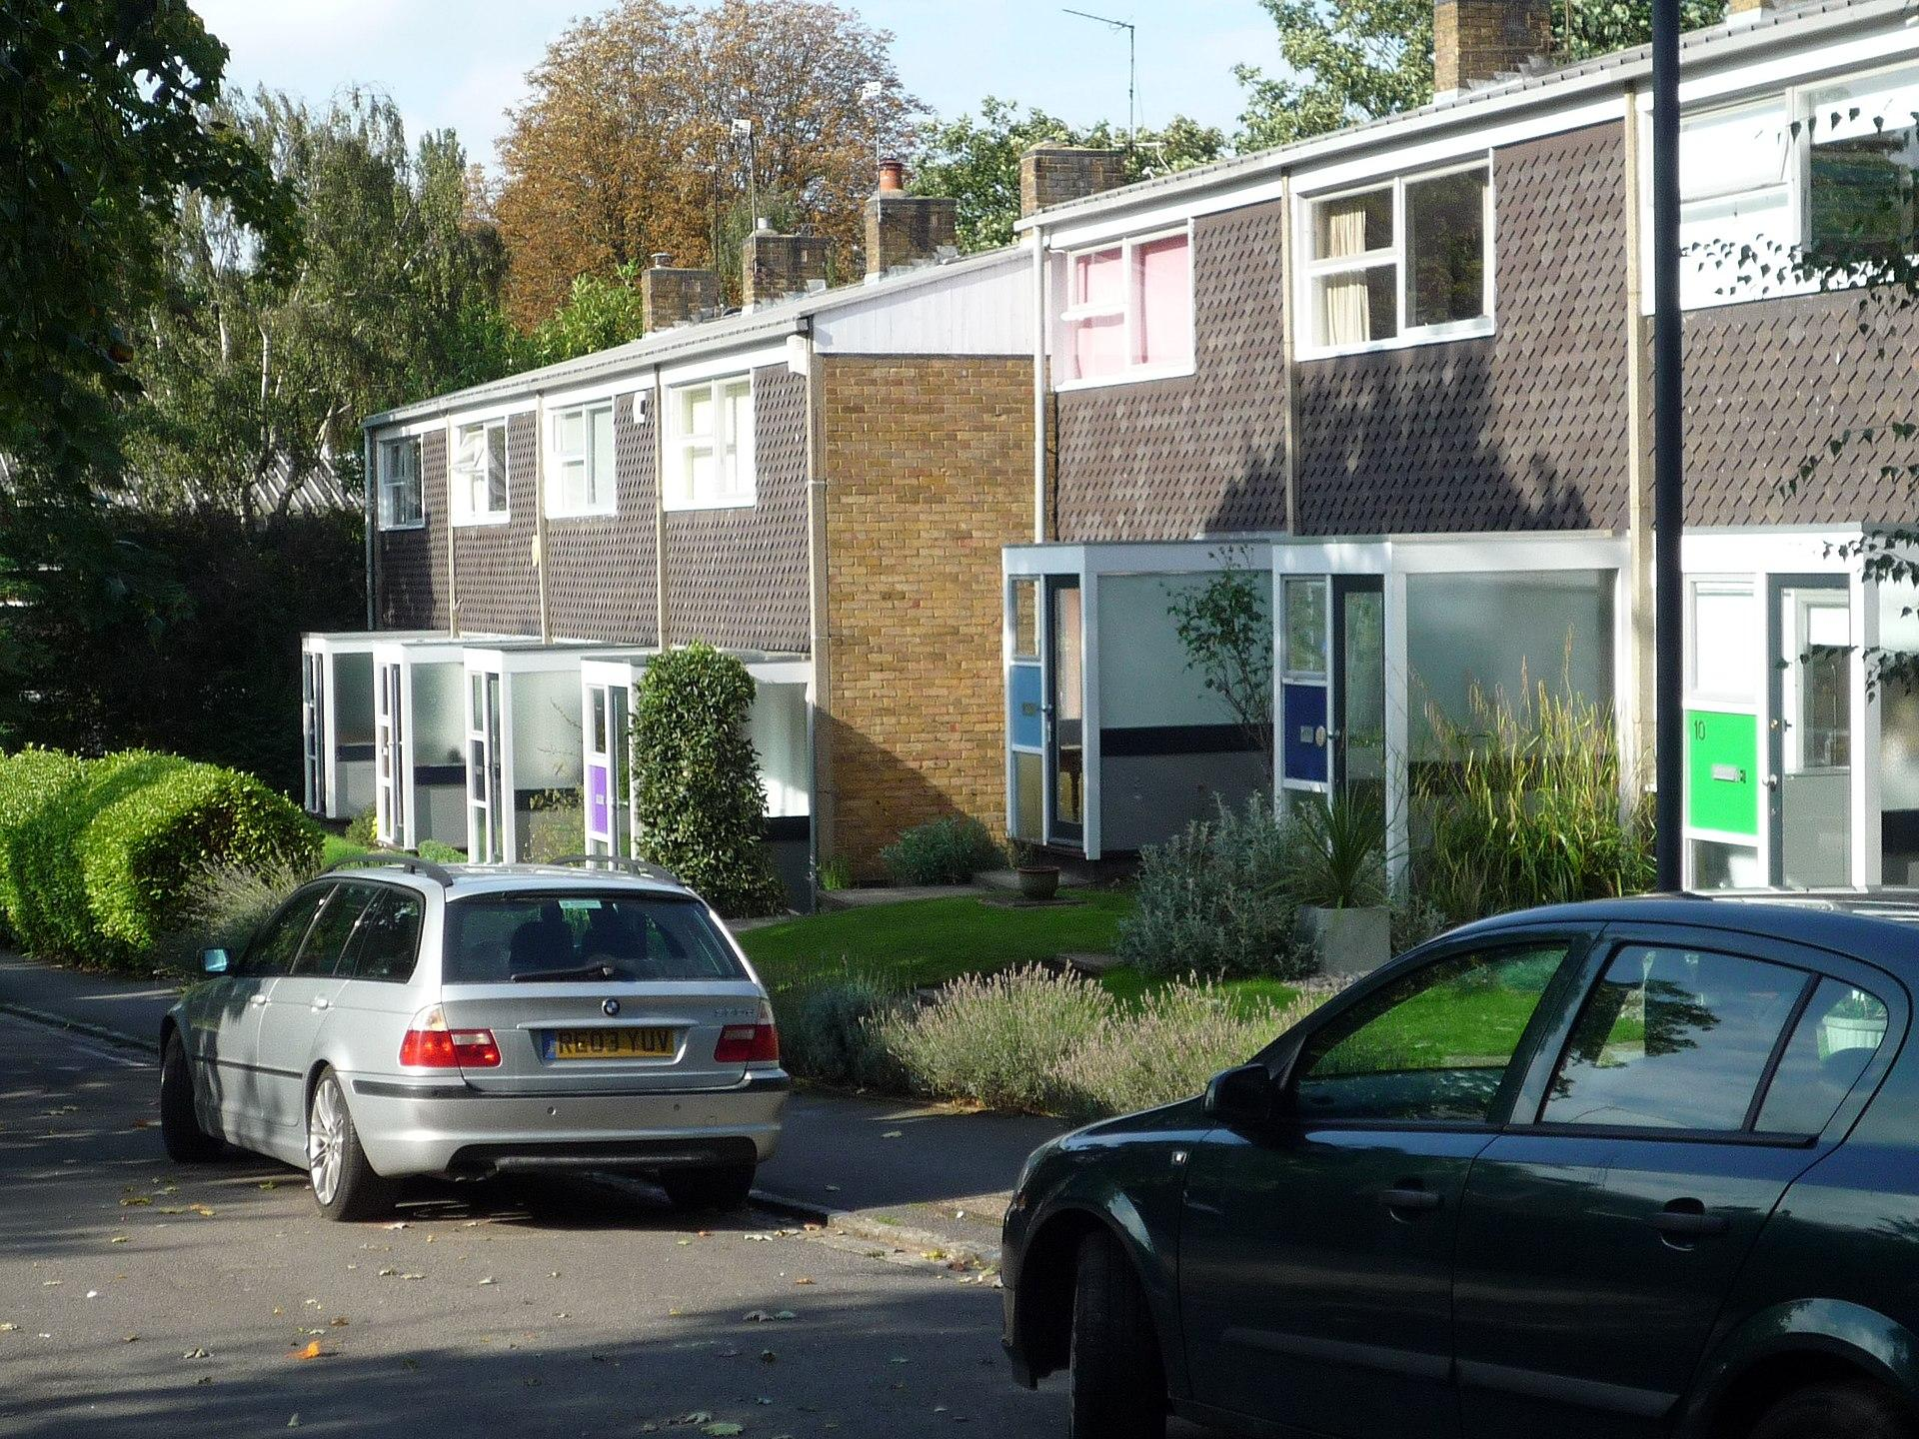
Non-traditional
https://commons.wikimedia.org/wiki/User:RHaworth

Slide 122
External wall insulation
- before
- as built

Slide 123
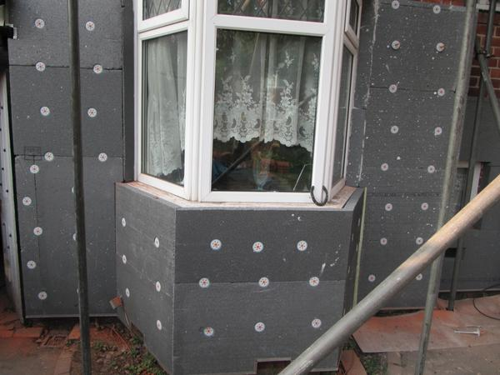
External wall
insulation - during

Slide 124
External wall insulation - after

Slide 125
Name that wall - quiz

Slide 126
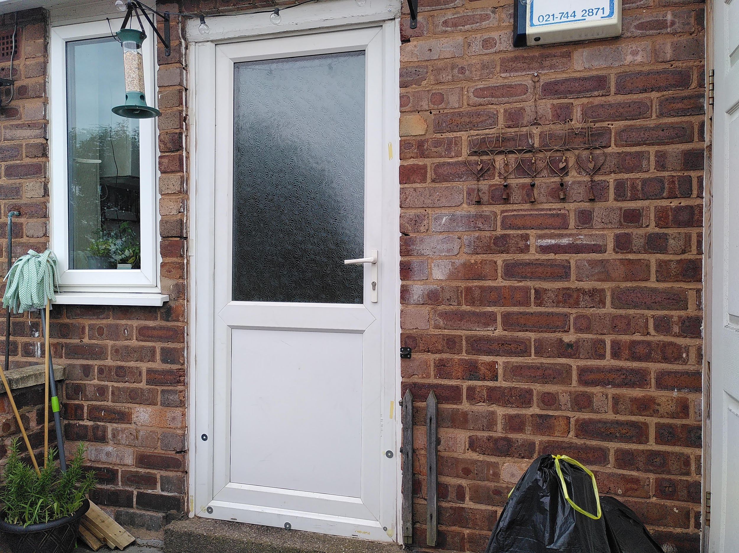
Name that wall - question 1
Name that wall - question 1

Slide 127

Name that wall - question 1
Name that wall - Question 2
Name that wall - question 1
https://en.wikipedia.org/wiki/User:Oosoom

Slide 128
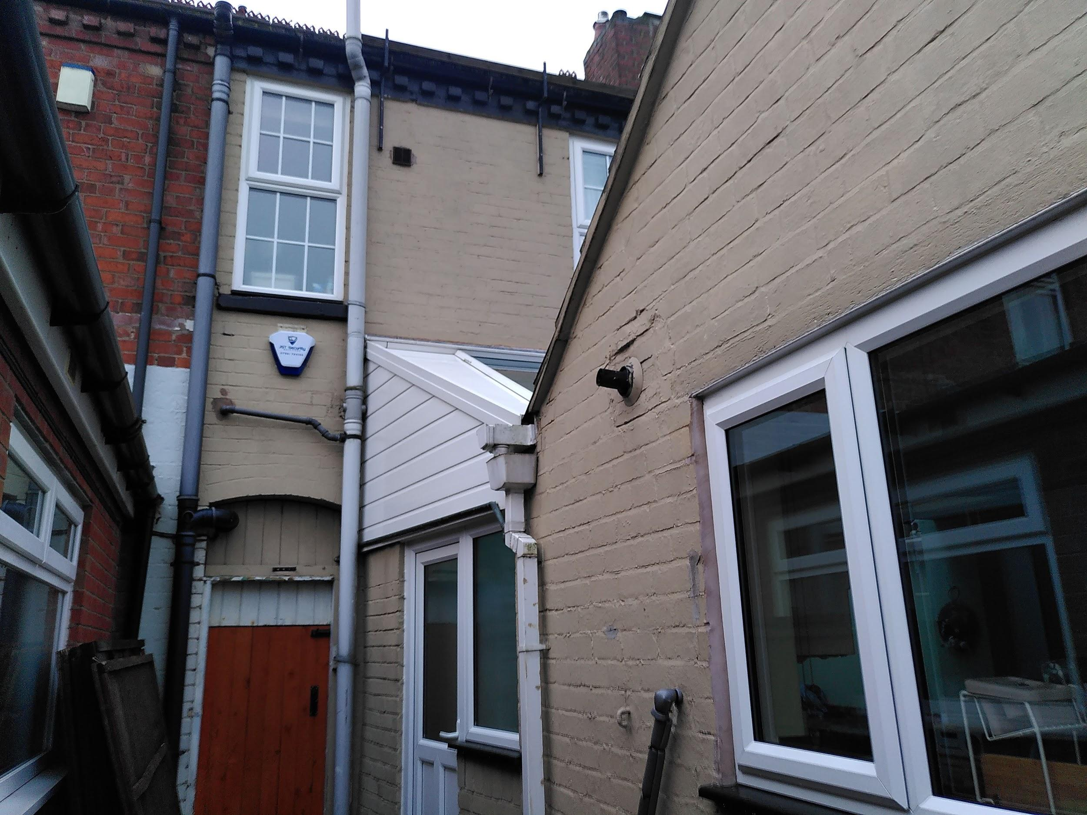
Name that wall - question 3

Slide 129
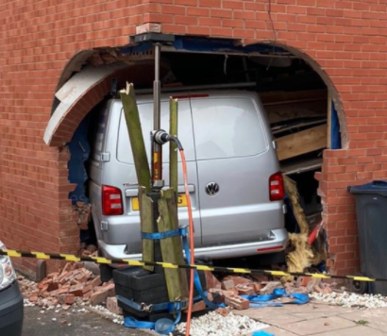
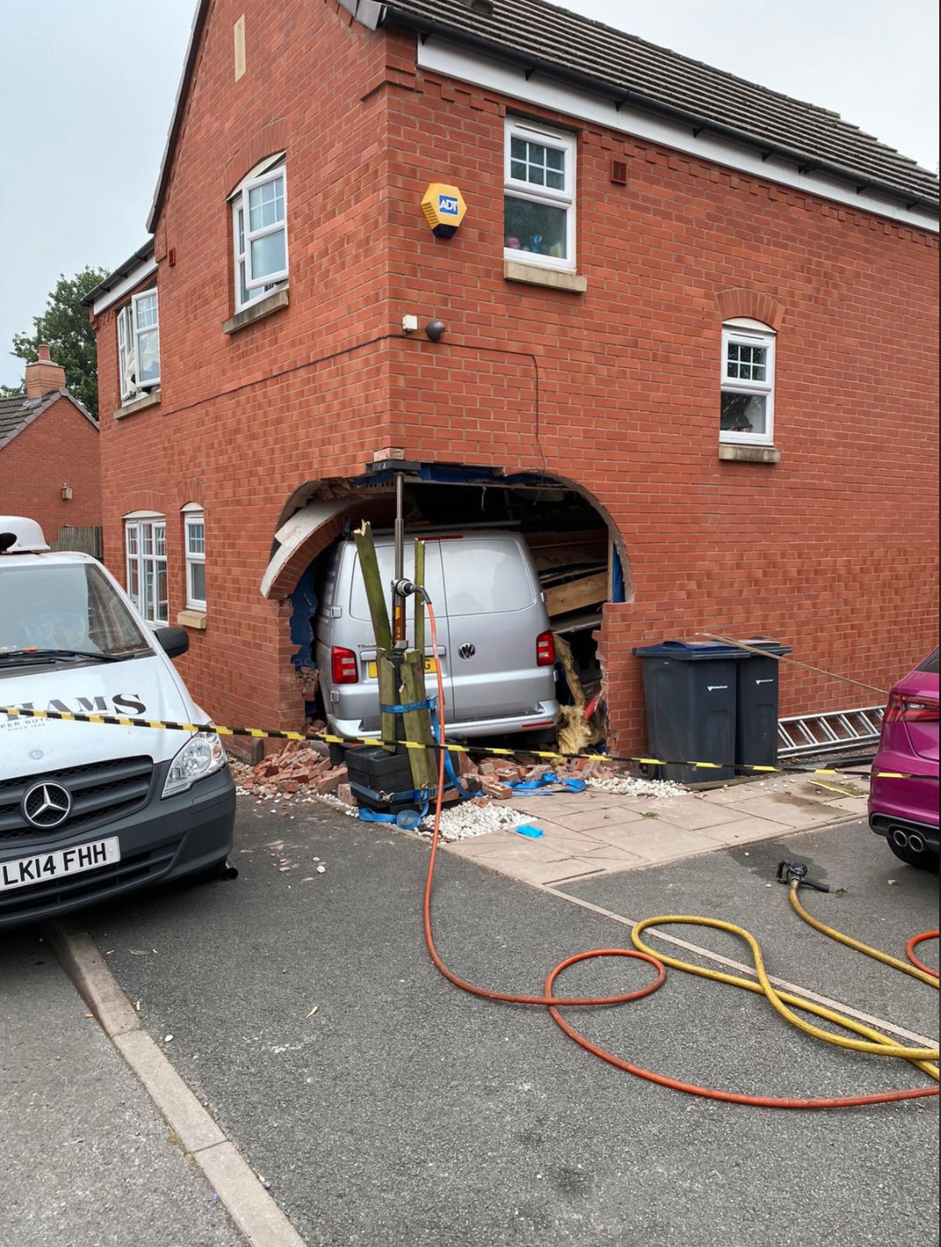
Name that wall -
Question 4
Photo: WMFS, Kings Norton fire station

Slide 130
Energy Performance Certificates
Must be produced when building or letting a property
Give us some useful information about energy performance of a home
A-G rating
F or G cannot be rented out
https://find-energy-certificate.digital.communities.gov.uk/
Homework - find your EPC

Slide 131
LED lighting
Most efficient light bulbs you can get
Available for all light fittings
Don’t forget fluorescent tubes e.g. in kitchens; bulkhead lamps e.g. in bathrooms, utility rooms, external lighting
Brighter
Longer lasting therefore less waste and greater lifetime savings

Slide 132
A case study ...

Slide 133
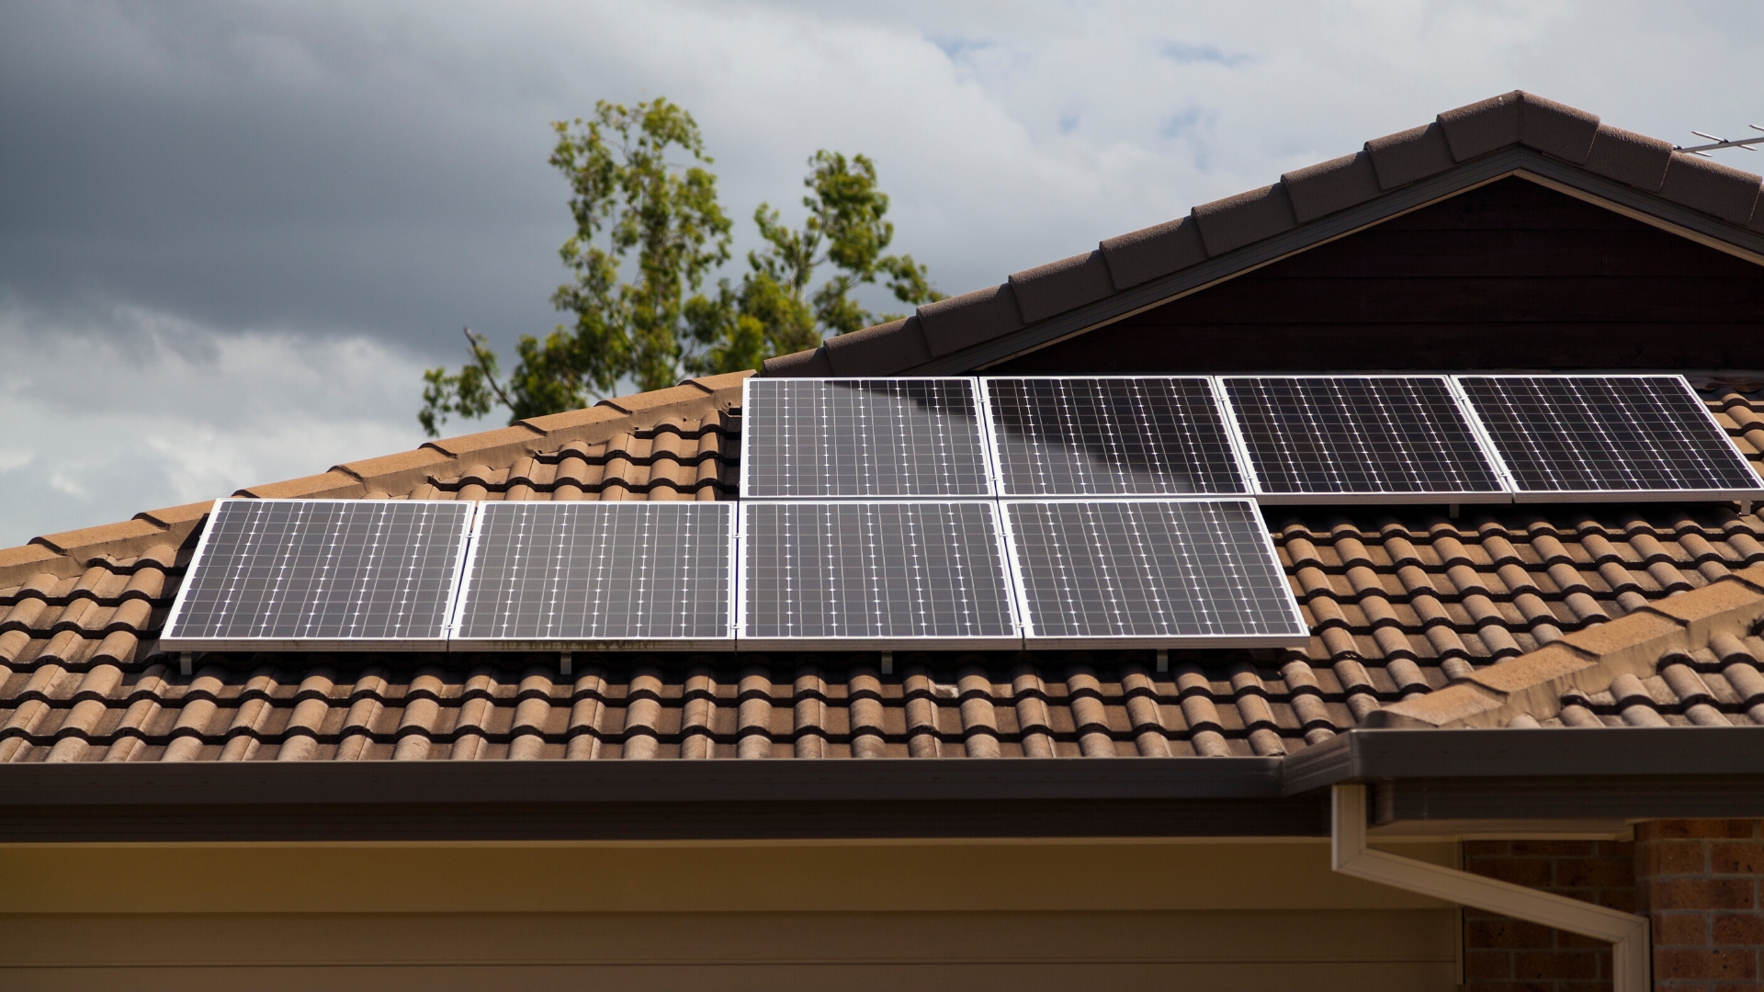
Renewable energy
Solar electricity (photovoltaics - PV)
Generates electricity when the sun shines
Will meet around half of a household’s electricity needs on average over a year
Savings will vary from household to household
Is rarely used for space heating in this country
Battery storage uncommon before 2020
Works best when appliance use is shifted to the middle of the day - e.g. washing machines, cooking

Slide 134
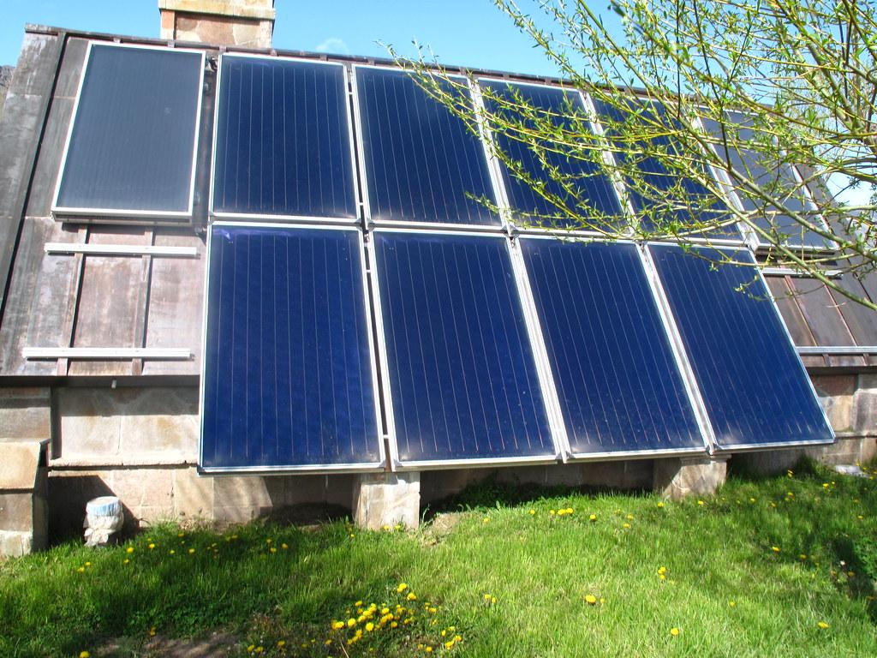
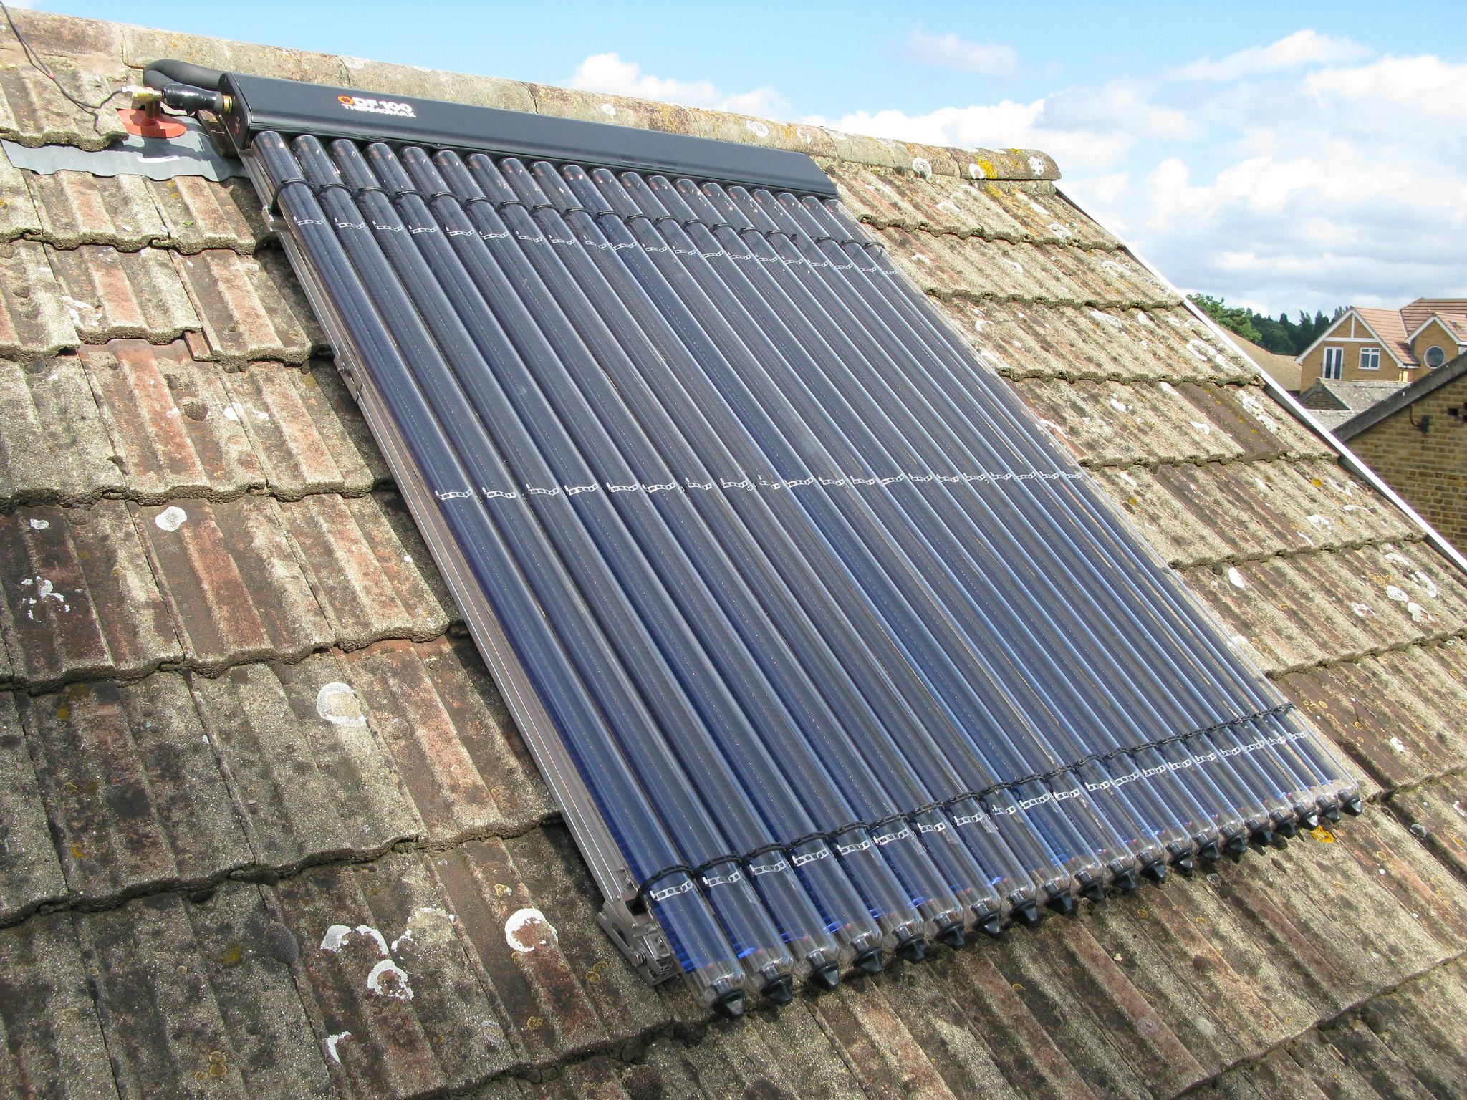
Renewable energy
Solar thermal (solar hot water)
Generates hot water for washing during daylight, including cloudy periods
Will meet around half of a household’s hot water needs over the year
Is rarely used for space heating in this country
Works with a hot water cylinder - if a combination boiler then cylinder will need to be added
Between October and March it’s best to use hot water later in the day to make the most of it
Less widespread in the UK than solar electricity
https://www.flickr.com/photos/a10/
https://www.flickr.com/photos/julianb/

Slide 135
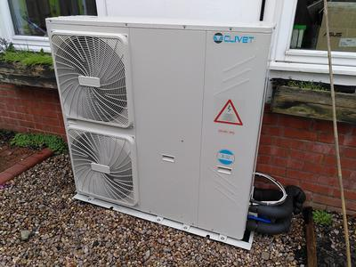
Renewable energy
Air source heat pumps
Uses electricity to pump heat from the air outside into the home
Home needs to be well-insulated to at least the standards of the 2010 building regulations
Works best with under-floor heating but can work with radiators
Can provide hot water as well as space heating but a secondary appliance such as an immersion heater may be needed
Detailed financial appraisal necessary - an ASHP in the wrong home can be an expensive mistake
https://www.flickr.com/photos/julianb/

Slide 136
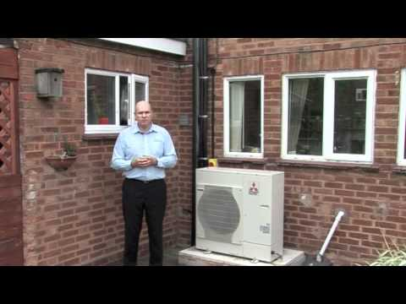
https://www.flickr.com/photos/julianb/

Slide 137
Green Homes Grant - how much and who is eligible
Households on low income - 100% grant up to £10,000
Everyone else - two-thirds grant funding up to a maximum of £5,000
England only
Vouchers will be issued from the end of September
Low income definition - Income based Jobseekers allowance (JSA) • Income based Employment & Support Allowance (ESA) • Income Support (IS) • Pension Guarantee Credit • Working Tax Credit (WTC) • Child Tax Credits (CTC) • Universal Credit (UC) • Disability Living Allowance (DLA) • Personal Independence Payment (PIP) • Attendance Allowance • Carer’s Allowance • Severe Disablement Allowance • Industrial Injuries Disablement Benefit • Contribution based Jobseekers allowance (JSA) • Contribution based Employment & Support Allowance (ESA) • Housing benefit
Homeowners only - owner-occupiers; private and social landlords (the landlord applies, not the tenant).
https://www.flickr.com/photos/julianb/

Slide 138
Green Homes Grant - primary & secondary measures
Primary measures
Insulation: Solid wall, cavity wall, under-floor, loft (virgin, top-up, NOT replacement), flat roof, room in roof, park home insulation.
- Low carbon heat: Air source heat pump, ground source heat pump, solar thermal
Secondary measures
Draught proofing
Windows and doors: Double/triple glazing (where replacing single glazing), secondary glazing (in addition to single glazing), upgrading to energy efficient doors (where replacing doors installed prior to 2002).
Heating controls and insulation: appliance thermostats, hot water tank thermostats, hot water tank insulation, smart heating controls
https://www.flickr.com/photos/julianb/

Slide 139
Green Homes Grant - primary & secondary measures
So long as there is at least one primary measure in the package of works, households will also be able to install secondary measures.
Secondary measures can only be subsidised up to the amount of subsidy provided for primary measures. (e.g. if a household receives £1,000 for primary measures, they can only receive a maximum of £1,000 towards secondary measures).
For low-carbon heating to be installed, households will need to have adequate insulation (e.g. wall and loft, where applicable).
These can be installed as part of a package – they do not have to already be in situ.
This is the energy saving hierarchy in action.
https://www.flickr.com/photos/julianb/

Slide 140
What’s next?
Emergency prepayment meter vouchers available from 1 March
Mentoring
philip.beardmore@gmail.com
Thank you for taking part

Slide 141
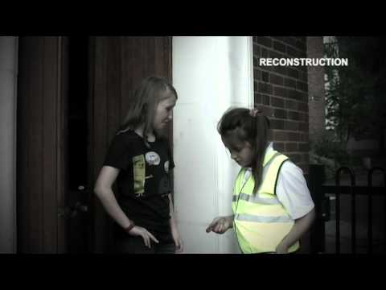

Slide 142
Carbon monoxide - who is most at risk?
Children
Older people
Older gas appliances
HMOs - homes in multiple occupation

Slide 143
Carbon monoxide - quiz

Slide 144
Carbon monoxide poisoning - your role
DO encourage people to get gas appliances serviced annually
DO NOT tell any individual you think they may be at risk of carbon monoxide poisoning, or give medical advice
Key message - Get gas appliances checked, and keep them safe.

Slide 145
Gas escapes
The smell of a gas escape is unmistakable - even the smallest leak will be detectable to anyone with a regular sense of smell
Evacuate all people and animals immediately
Open doors and windows to let the gas escape
Phone the gas emergency number 0800 111 999
Wait outside for the gas emergency service to arrive
Do not smoke or use naked flames
Do not turn any electrical switches on or off including light switches
Do not use doorbells, mobile phones or any device that could cause a spark.

Slide 146
Which uses most water?
Quiz turn this into a Zoom quiz if we do water on week 5

Slide 147
Which uses most water? Answers
bath 80 litres
5 minute power shower 75 litres
washing machine 50 litres
5 minute boiler-fed shower 45 litres
washing up running tap for 5 minutes - 6 litres per minute - 30 litres
washing up bowl 9.5 litres
Single flush toilet 9 litres

Slide 148
Low cost ways to save water
Washing machine settings
Save-a-flush in older (single-flush) toilets
Shower timer
Washing-up bowl
Water saving shower head.

Slide 149
How many people in the UK have water meters?
Do Zoom quiz if time

Slide 150
How many people in the UK have water meters?
48%

Slide 151
What’s next?
Mentoring
philip.beardmore@gmail.com

