Slide 1
Emergency fuel voucher scheme

Slide 2
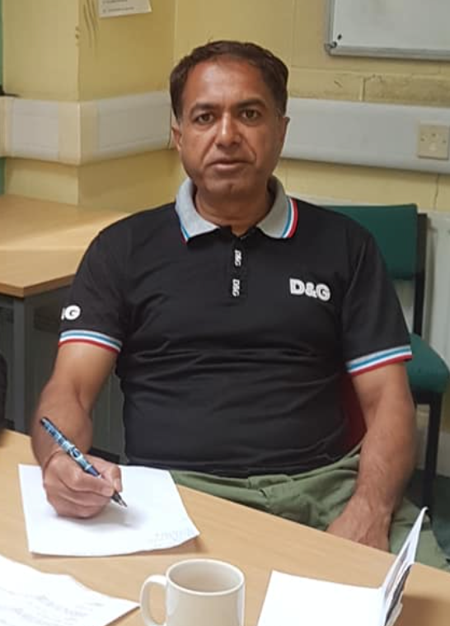
About Saltley Community Association
Shahid Mir
Safdar Mir

Slide 3
Eligibility criteria
A prepayment meter for electricity, or gas, or both
At risk of running out of credit (self-disconnection)
Lacks the means to top-up
Both boxes below must be ticked on the application form to qualify for a voucher

Slide 4
Eligibility criteria
A prepayment meter for electricity, or gas, or both
At risk of running out of credit (self-disconnection)
Lacks the means to top-up
Both boxes below must be ticked on the application form to qualify for a voucher
✅
✅

Slide 5
Means of verification
You (the person making the referral) need to have seen any one of:
The prepayment meter, or a photo of the prepayment meter, or
The top-up card, or a photo of the top-up card, or
A letter from the energy supplier(s) showing that the household has a PPM
You do not need to submit this evidence when making the referral, only to confirm that you have seen it.
There is no means-testing.
There is a small prize for the first person who can show a letter from an energy supplier showing that the household has a PPM.

Slide 6
Referral procedure
You will need the following information about the client:
Name and address
Vulnerabilities, if you know them
Who is their energy supplier
PayPoint or Post Office? (British Gas customers cannot redeem vouchers at PayPoint)
There are some new equal opportunities monitoring questions - optional
Please tell us briefly what other support you have given them, if any
Referrals are made using this form https://forms.gle/CQbMp9TV5VeY6XCY6

Slide 7
What happens next
The voucher code is sent to the email address of the person making the referral
You then forward the content of the email (preferable) by SMS or email to the client, and they go to the shop themselves with their top-up card. You should not normally go to the shop.
Email is preferable so the client can show the whole email to the outlet
Only if the client is unable to leave the house, e.g. self-isolating, shielding, or housebound, can you go to the shop on the client’s behalf, in which case you will need to go to the shop with their top-up card
We will make referrals once a day. This means that the client may have to wait 24-48 hours to receive the top-up. This scheme is designed to help people in need but is not an emergency service. It is a grant to the householder that does not need to be repaid. Vouchers can be redeemed at all PayPoint (not British Gas) and Post Office outlets

Slide 8
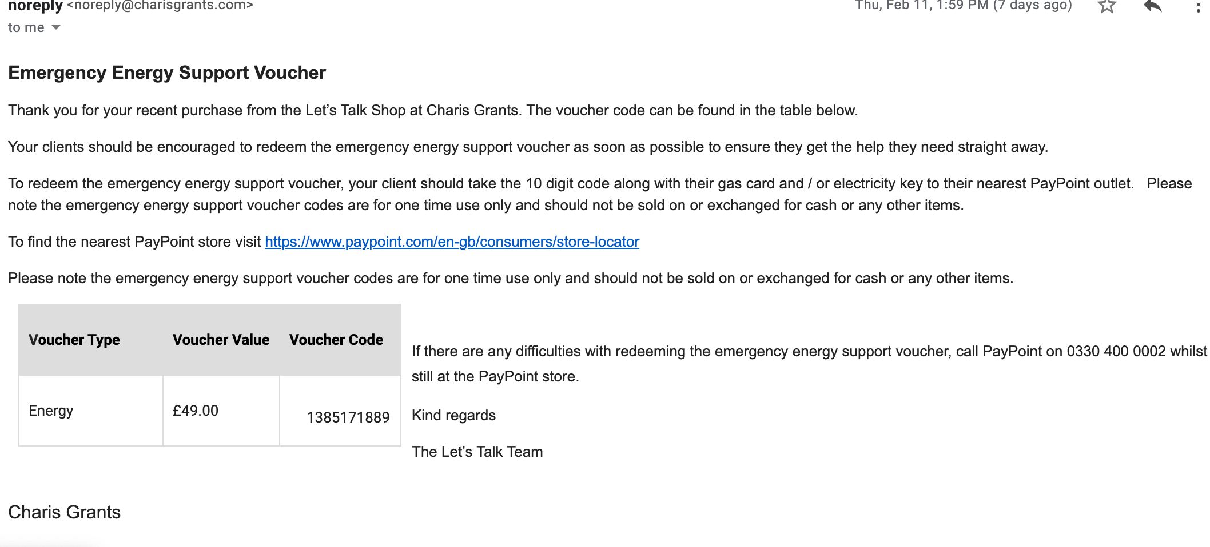
Example of PayPoint voucher email

Slide 9
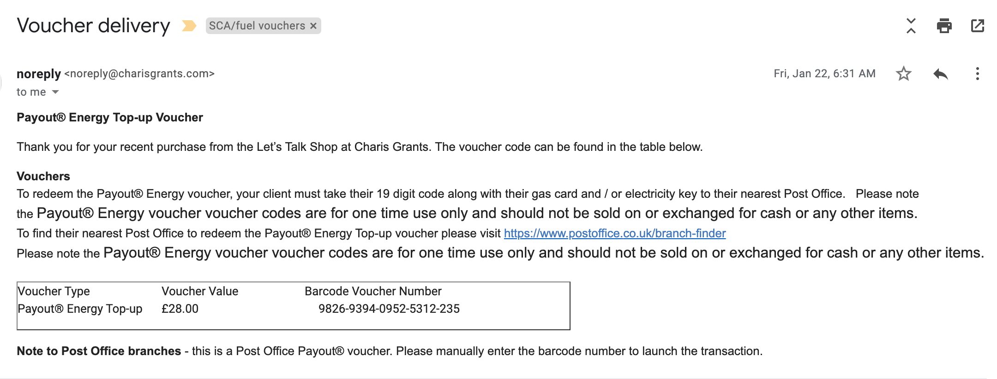
Example of Post Office voucher email

Slide 10
Allocations
£49 for a family voucher
£28 for a single person voucher
Each household can receive up to three vouchers, if they need them, however you should not advertise this fact or make promises - we have a limited availability of vouchers and there is no guarantee that there will be sufficient vouchers for a household to have more than one
Do not advertise the availability of vouchers to the public, they should only be allocated to people you are already helping, when you identify a risk of self-disconnection

Slide 11
Allocations
We have approximately 1,000 vouchers; allocation is first-come, first-served
We will pay referral fees for organisations who refer more than 30 people. We will announce the referral fees in due course but it will be less than last time and there will be a maximum and a minimum.
The vouchers must be spent by 31 August 2021
If the project is a success then we will apply for more vouchers from the funder (Energy Redress), if available.

Slide 12
What if the shop refuses to redeem a voucher?
On the last voucher project:
99% of Post Office vouchers were redeemed first time
97% of PayPoint vouchers were redeemed first time
There are clusters of PayPoint stores in certain areas of Birmingham that are more likely to refuse.

Slide 13
Hints and tips for getting vouchers redeemed
Paypoint have a webpage which provides details of stores who have recently redeemed Energy or Cash vouchers and will be familiar with the process- https://consumer.paypoint.com/cashout
For Post Office vouchers, the redemption outlets (Post Office Counters) can be in newsagents or other local convenience stores. The Post Office vouchers must be taken to the indicated Post Office counter within the store which may be separate from the general shop counter.
Payzone vouchers cannot be bought through the Charis platform.
Paypoint and Post Office vouchers cannot be redeemed at Payzone outlets.
Paypoint clients can call the Paypoint helpline number whilst they are in the store if they are having redemption problems. Paypoint are investigating why this level of support is not, in some cases, proving helpful or providing a solution.

Slide 14
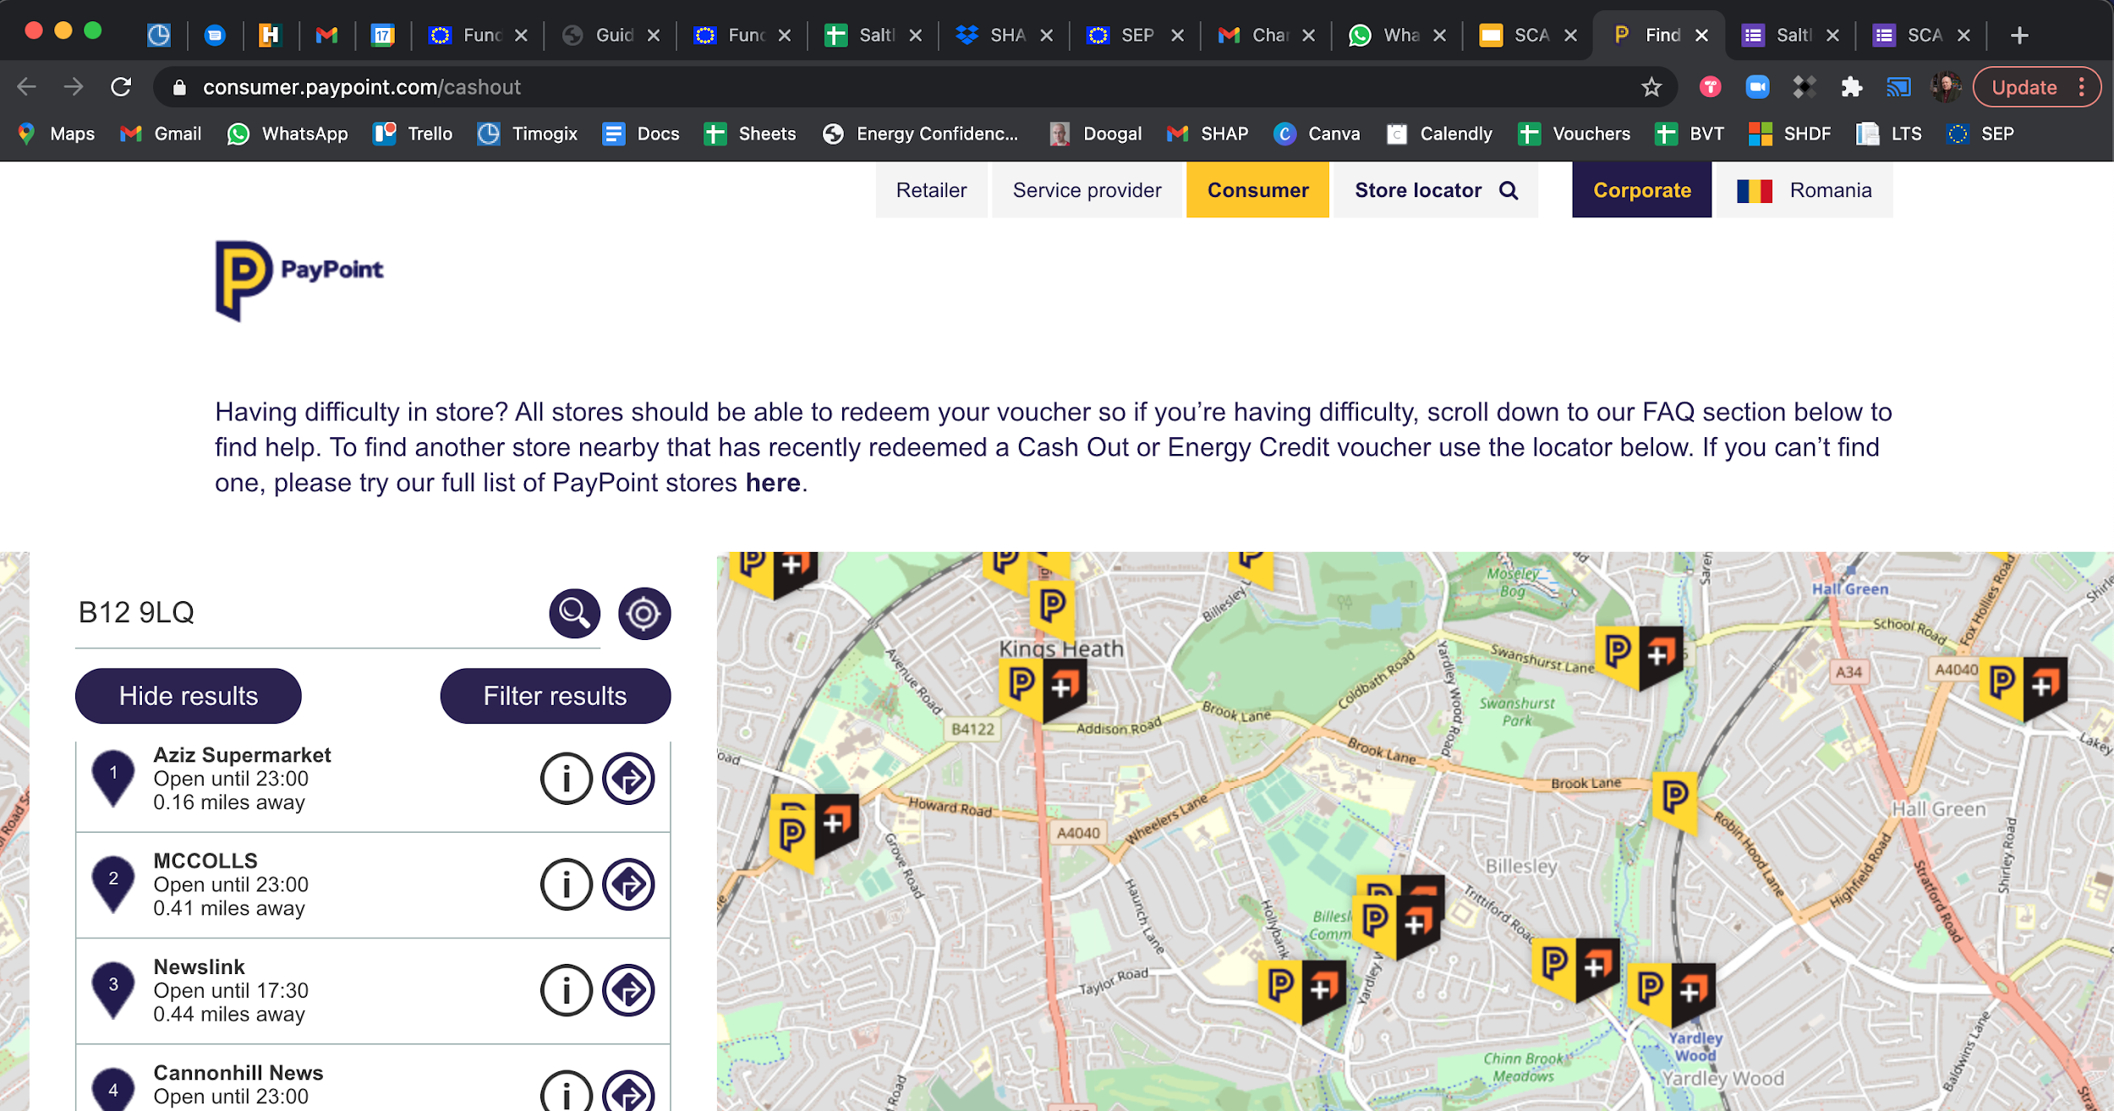

Slide 15
What if the PayPoint refuses to redeem a voucher?

Slide 16
These instructions will be included in voucher emails

Slide 17
Explain this to PayPoint outlets
“[I] explained to them that they needed to press the Cash Out button to generate the ‘cash in the till’ and then use that to process the fuel top-up. Both retailers were really suspicious of doing it, and it took some persuading – customers have reported that they had to just leave the shop without any fuel as they were refused assistance.”

Slide 18
When you have exhausted all these options ...
Report the problem using this form https://forms.gle/MvuinkqGmqobaFHdA
Do not report voucher redemption issues by email

Slide 19
Any questions?

