Slide 1
Helping people in fuel poverty
For community workers and volunteers

Slide 2
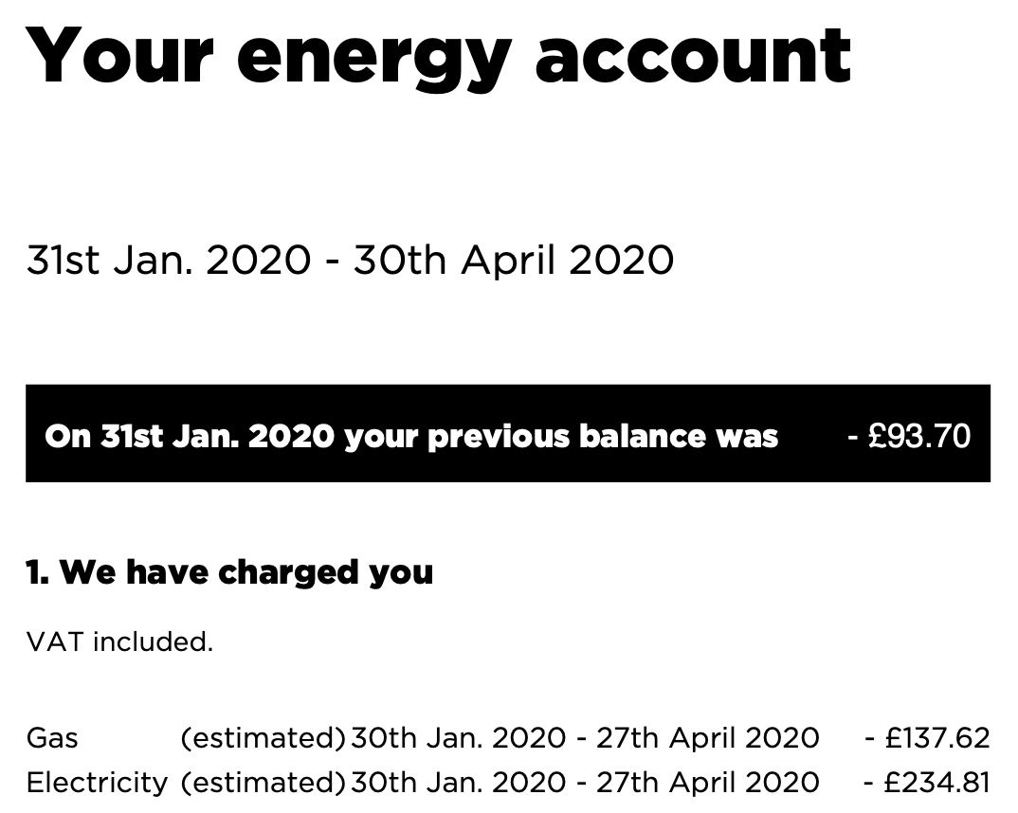
Estimated bills

Slide 3
Estimated bills
A series of underestimated bills will lead to a build-up of debt - back-billing
You cannot be back-billed for fuel used more than 12 months ago if you were incorrectly charged by the supplier
This does not apply if the householder has refused access to meter inspectors, or tampered with the meter.
The supplier should agree a payment arrangement on any remaining debt that you can’t settle straight away
https://www.citizensadvice.org.uk/consumer/template-letters/letters/energy/complain-to-a-supplier-about-back-billing/
Over-estimated bills lead to over-payment and you should get a refund

Slide 4
Payment methods
Suppliers are obliged to offer a range of payment methods to consumers
Including direct debit, payment on receipt of bill, monthly payment scheme, prepayment meters, Fuel Direct
British Gas have recently restricted payment options for their prepayment customers by withdrawing from PayPoint as a payment method

Slide 5
Debt and disconnection - supplier obligations
Suppliers must make payment arrangements if a consumer is experiencing financial difficulties
Payment by instalments weekly, fortnightly, monthly
Inform the consumer of Fuel Direct if applicable
Offer to fit a PPM if safe and practical
Offer energy efficiency advice
Take into account money advice and recommendations from third parties

Slide 6
Debt and disconnection - consumer obligations
If charges are disputed, continue to pay what they think is the correct amount
It is advisable to take independent advice including preparing a personal budget
Disconnection is rarely used by suppliers for debt nowadays.

Slide 7
Disconnection - supplier obligations and voluntary codes
Prohibited from disconnecting a premises occupied by a customer who is eligible for the Priority Services Register 1 October - 31 March
The Energy UK “Safety Net” - a pledge to never knowingly disconnect a vulnerable household
You cannot be disconnected for debt owed to a former supplier
A bankrupt cannot be disconnected for debt built up before bankruptcy

Slide 8
Priority Services Register - who provides it
Gas and electricity suppliers
Gas transporters (network operators) - Cadent
Electricity distribution network operators - Western Power Distribution

Slide 9
Priority Services Register - eligibility
Of pensionable age, or
Have a disability (including impaired hearing or vision), or
Are chronically sick
Some suppliers also have families on benefits with a child under 5 on their PSR
Some of the benefits of the PSR have additional criteria

Slide 10
PSR - free annual gas safety check
Homeowner, and
Live alone, pensionable age or disabled or chronically sick
Live with others, and all occupants are pensionable age, disabled or chronically sick
Receive means tested benefits with a child under 5 (British Gas only)

Slide 11
PSR - other free services
Priority notice for electricity supply interruptions if you have essential medical equipment
Alternative arrangements if gas supply interrupted – alternative cooking and heating – also priority for reconnection - if everyone is on PSR
Password identification for supplier and transporter/distributor
Nominated bill receiver/payer
Alternative bill formats – large print, Braille, talking bill
Repositioning of emergency control valve

Slide 12
PSR - how to sign up
There is a data sharing agreement in place
This means if you contact your energy supplier, Cadent or Western Power Distribution, then you can be placed on all the relevant PSRs
Google “Cadent” or “WPD” or “name of energy supplier” plus “PSR”
Separate process for Severn Trent’s PSR

Slide 13
Warm Home Discount

Slide 14
Warm Home Discount
£140 discount on the electricity bill for qualifying households
Guarantee Credit element of Pension Credit - this is the WHD “Core Group” and automatically gets WHD credited to their bill
Your name or your partner’s is on the electricity bill
Your energy supplier must be part of the scheme - some smaller suppliers are not part of the scheme
If you have a pre-payment meter, the WHD is added as a credit to the meter

Slide 15
Warm Home Discount
Additionally, there is the “broader group” who qualify
Means-tested benefits
Suppliers have their own criteria
You or your representative must apply to the energy company
Smaller suppliers are not part of the scheme
If you change supplier at the wrong time you may no longer qualify
Many people miss out on it, and need help and encouragement to apply
There is also a Park Homes Warm Home Discount

Slide 16
Why room temperatures matter

Slide 17
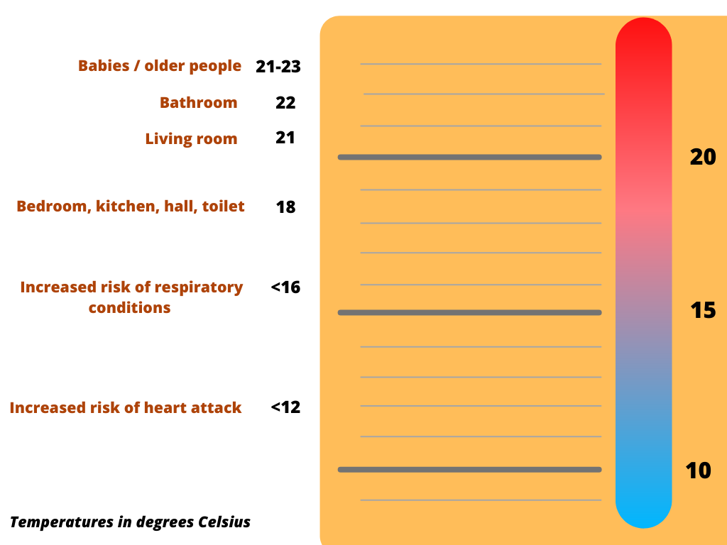

Slide 18
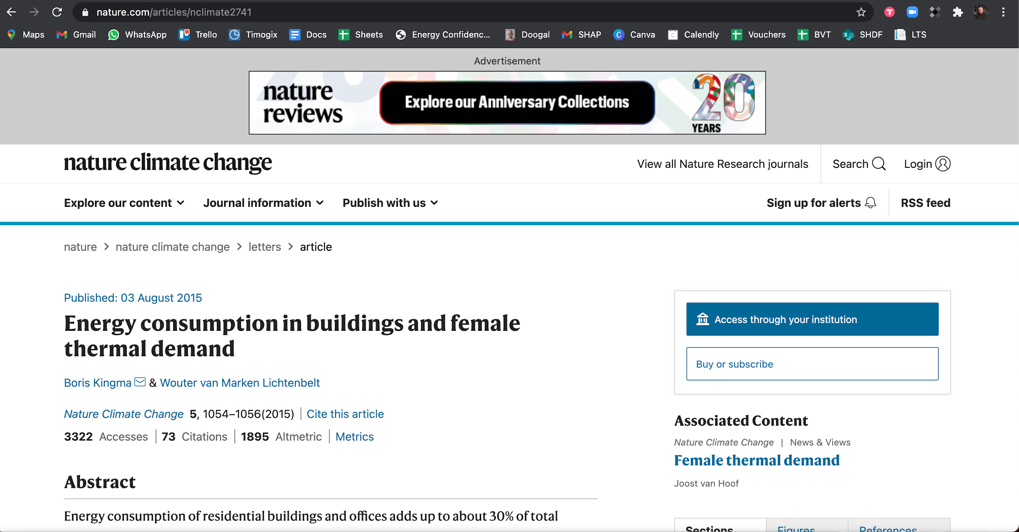

Slide 19
Wet central heating systems
Central boiler heats water
Hot water is distributed through pipes to heat exchangers in floors or walls, or usually through radiators
Mains gas is the most common fuel
Hot water can be used for washing instantaneously (combination boiler) or stored (system boiler with hot water cylinder)
Condensing boilers are most efficient. A condensing boiler can be a condensing combination boiler or a condensing system boiler.

Slide 20
Condensing gas boilers
Have a second heat exchanger that makes them more efficient than pre-2005 boilers
Can be Condensing Combination boilers (instantaneous hot water) or Condensing System/Conventional boilers (hot water stored in cylinder)
A condensate pipe is a good way to recognise a condensing boiler

Slide 21
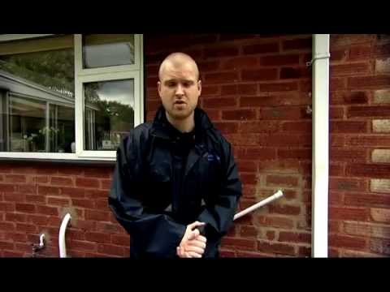

Slide 22
Warm air heating systems
A central unit warms air
Warm air is distributed by fans through ducts to outlet registers throughout the house
Filters remove dust particles
Electrostatic filters can be fitted to remove pollens
Mains gas is the most common fuel

Slide 23
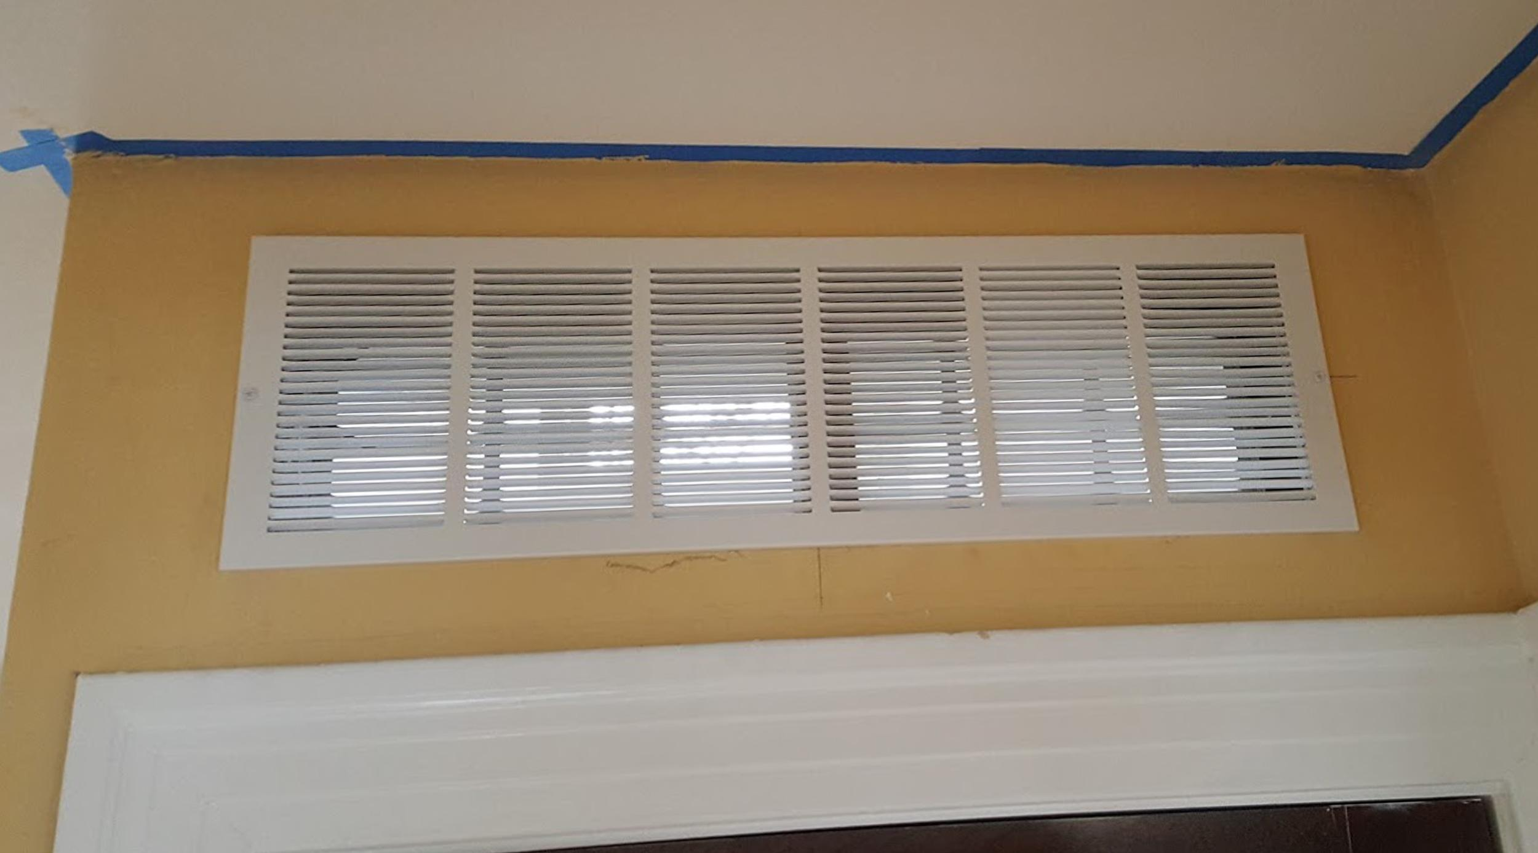
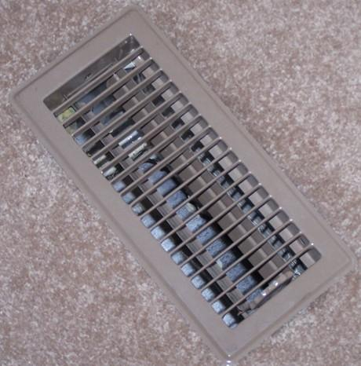
Images:
By Angelsharum - Own work, CC BY-SA 3.0, https://commons.wikimedia.org/w/index.php?curid=33132962
By Tim Evanson - https://www.flickr.com/photos/23165290@N00/25432805376/, CC BY-SA 2.0, https://commons.wikimedia.org/w/index.php?curid=47293036

Slide 24
Electric storage heating systems
Heat storing materials such as concrete, ceramics, oil, water are heated up during off-peak periods such as night-time
The heat is stored to be released during the following day
The age of the appliances, the sophistication of its controls, the heat storage properties of the heat storing material all affect the efficiency of the heating system

Slide 25
Electric under-floor heating systems
Electric elements placed within the concrete floor slabs heat the floor during off-peak periods
Heat is then released from the slab
There is little control over the heating system
Common in 1960s in high-rise buildings
Best suited to modern, highly insulated properties where constant heat output is required

Slide 26
Portable individual heaters
Fuels include bottled gas, electricity, paraffin, heating oil
Bottled gas and paraffin often banned by social housing providers through tenancy agreement
Risk of trips and falls
Carbon monoxide and condensation risks from bottled gas, paraffin, heating oil due to ventilation issues

Slide 27
Community/district heating systems
Combined heat and power – efficient way of producing electricity, heat and hot water – fuelled by gas or biomass
Very widespread in many parts of Europe and beyond
Quite rare in the UK, occasionally found in tower blocks and other high-density housing, more commonly found in hospitals, factories, universities
Micro-CHP systems are now available

Slide 28
Air source and ground source heat pumps
Should only be used in a highly insulated building
People need to be shown how they work
A secondary source of domestic hot water may be needed e.g. immersion heater, in which case people need to be shown how to control the immersion heater

Slide 29
Heating appliance and system controls
Time switches and programmers
Air temperature thermostats
Thermostatic radiator valves
Hot water cylinder thermostat
Input/output charge controls (storage heaters)
When did you last adjust yours?

Slide 30
Timers, programmers and timer/programmers
Clock-based units that control when space and water heating system switches on and off
Mechanical or digital
On and Off periods, which may be repeated over a 24 hour or 7 day cycle
Have 'override' or 'advance' options so system can be used outside of times that the system is programmed to operate

Slide 31
