Slide 1

The Green Homes Grant
Your questions answered

Slide 2
What we will cover in this webinar
Giving you the confidence to get the right measures from the right installer
Understanding the right order in which to do things
What measures you can get under the Green Homes Grant
Who is eligible for a Green Homes Grant voucher?
How much is a voucher worth?
Eligibility for the low income element of Green Homes Grant
How to register for the Green Homes Grant
Planning issues
Examples of how a voucher might be spent
How will I know if I am better off?
No insulation without ventilation
What to ask installers
The benefits of independent impartial advice
Q&A

Slide 3
Primary & secondary measures
Primary measures
Insulation: Solid wall, cavity wall, under-floor, loft (virgin, top-up, NOT replacement), flat roof, room in roof, park home insulation.
Low carbon heat: Air source heat pump, hybrid air source heat pump, ground source heat pump, solar thermal, wood pellet boilers
Secondary measures
Draught proofing
Windows and doors: Double/triple glazing (where replacing single glazing), secondary glazing (in addition to single glazing), upgrading to energy efficient doors (where replacing doors installed prior to 2002).
Heating controls and insulation: appliance thermostats, hot water tank thermostats, hot water tank insulation, smart heating controls

Slide 4
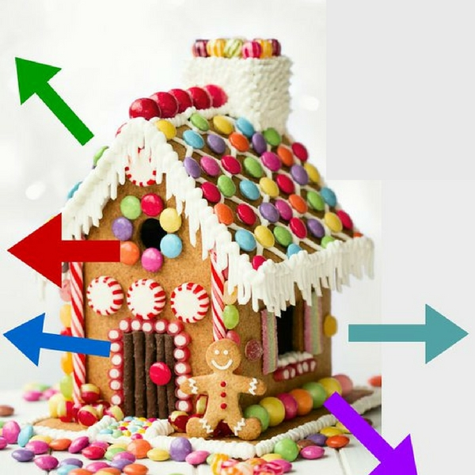
How is lost through a home? - quiz

Slide 5
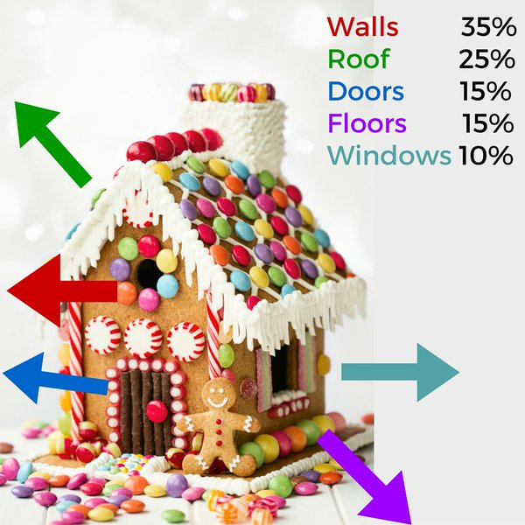
How heat is lost through a home - answers

Slide 6
Heat loss depends on:
The properties of the building element:
Thermal conductivity - the rate at which a building element will allow heat to pass through it
Surface area of element - how big an area it has for heat to transfer through
This is why more heat is lost through walls, roofs and floors, than through windows and doors.
Thermal bridges - where building components with different thermal properties meet

Slide 7
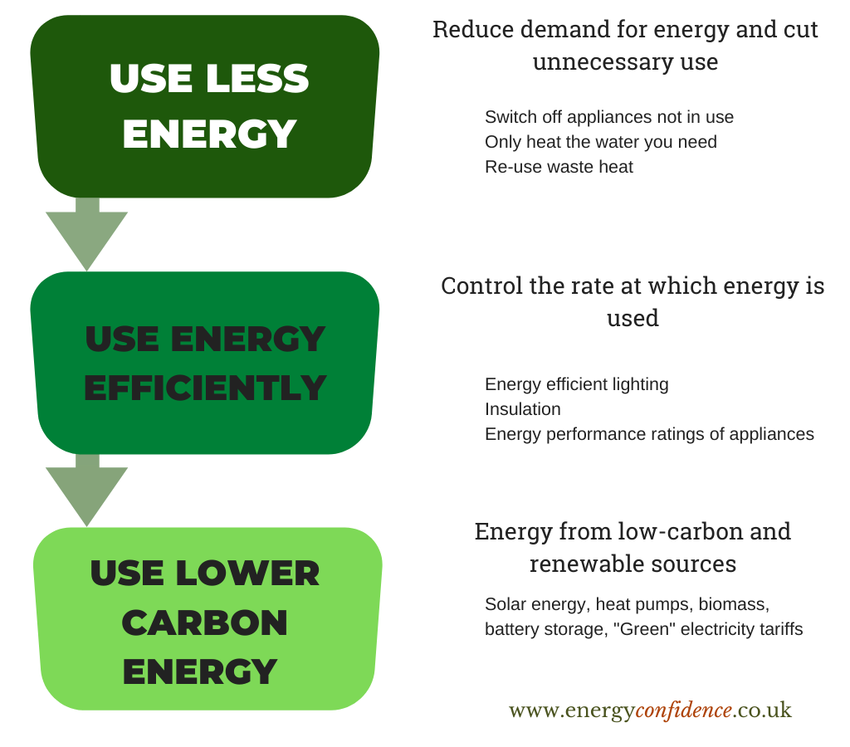
The energy saving hierarchy

Slide 8
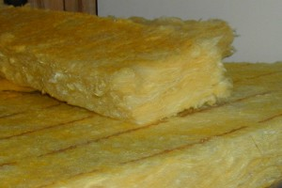
Loft insulation
- don’t forget the loft hatch pillow
- make sure the installer doesn’t leave gaps including around the eaves
https://pl.wikipedia.org/wiki/User:Radomil

Slide 9

Solid wall brick pattern
http://freestocktextures.com/texture/id/690

Slide 10
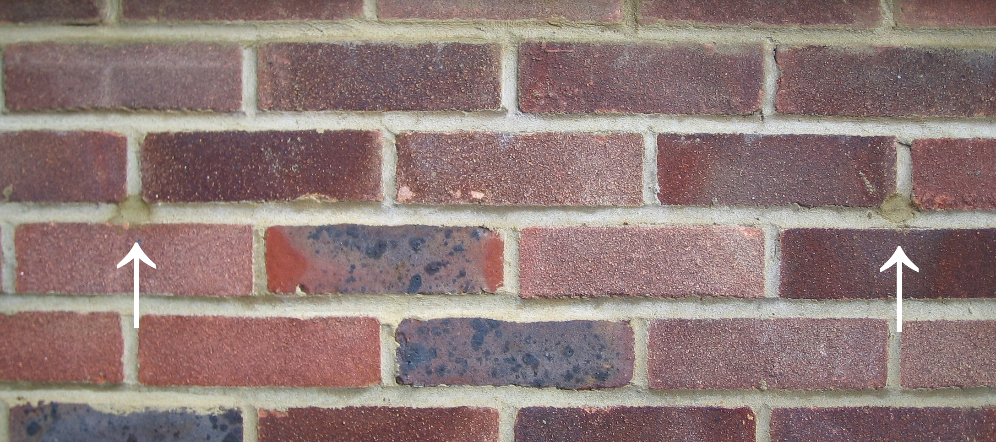
Cavity wall brick pattern

Slide 11
Cavity wall brick pattern with insulation drill holes

Slide 12
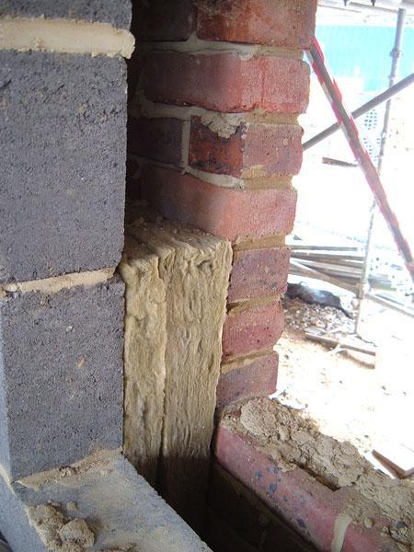
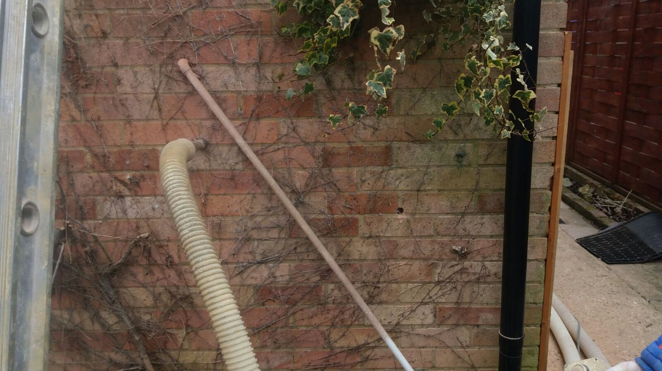
Cavity wall insulation
- as built
Cavity wall insulation
- retrofit
https://en.wikipedia.org/wiki/user:Mok9
https://commons.wikimedia.org/w/index.php?title=User:Workworkwembley

Slide 13
External wall insulation
- before
- as built

Slide 14
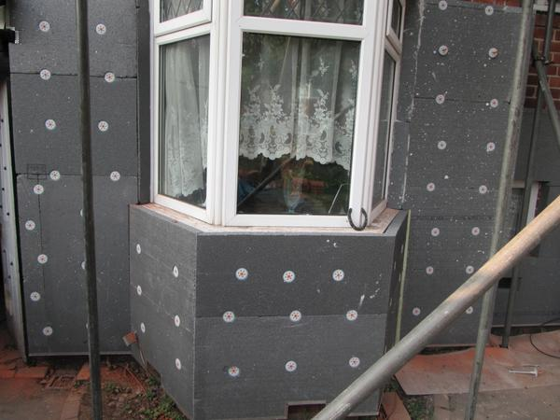
External wall
insulation - during

Slide 15
External wall insulation - after

Slide 16
External wall insulation
Increases thermal comfort
No internal disruption
More expensive than CWI
Some people have partial EWI and partial IWI

Slide 17

Internal wall insulation
Similar results to EWI
Internally disruptive
Some loss of space
Can be cheaper than EWI
Can be done room by room
Some people do a mixture of IWI and EWI
Image - Six Star Insulation

Slide 18
Wall type quiz - name that wall

Slide 19
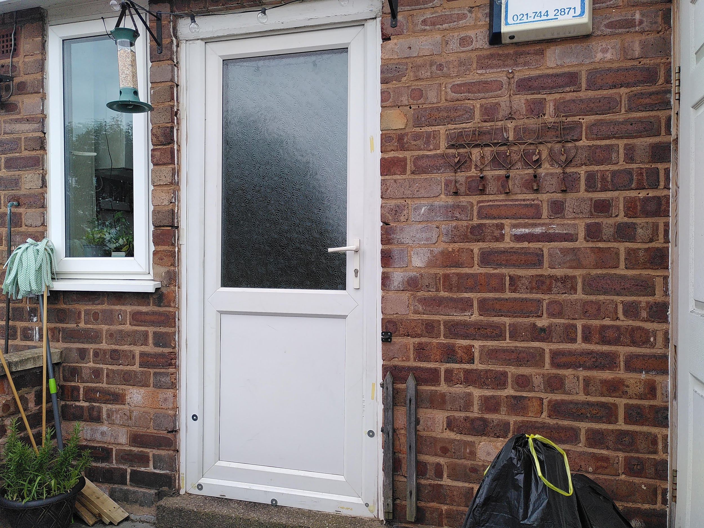
Name that wall - question 1
Name that wall - question 1

Slide 20

Name that wall -
question 2

Slide 21
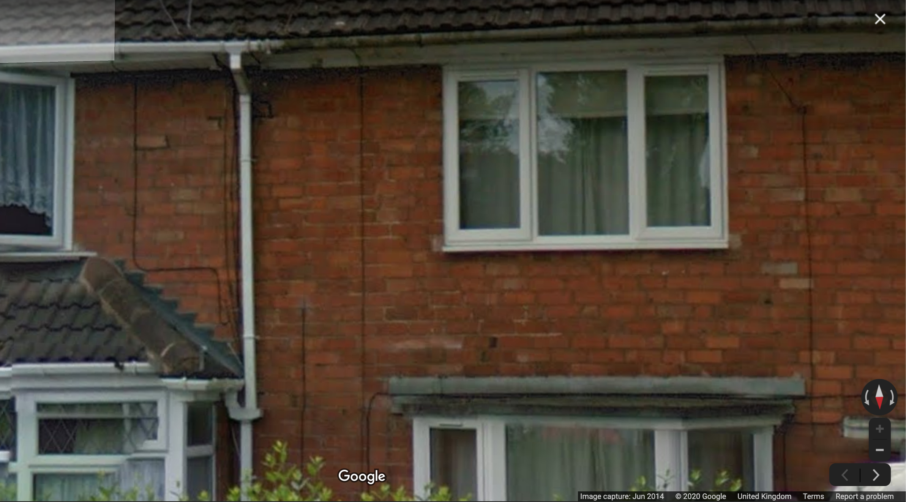
Name that wall - question 3

Slide 22

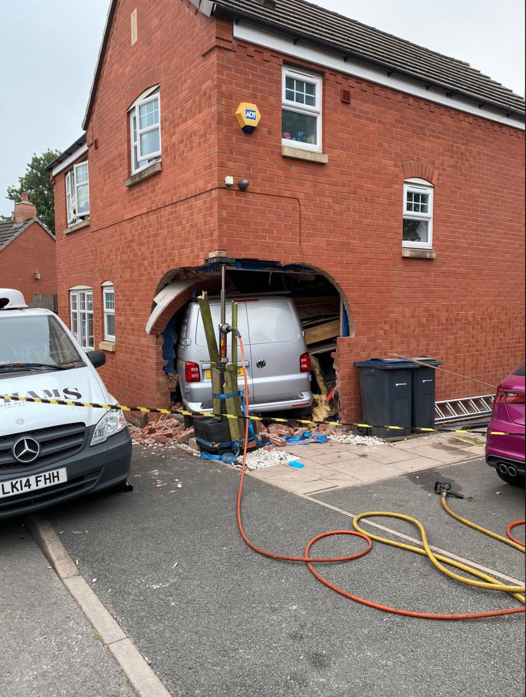
Name that wall -
Question 4
Photo: WMFS, Kings Norton fire station

Slide 23
Heating controls
Heating controls quiz
Why this matters - most of us are using the same type of controls we had last century, and in the same way, which is what caused the problem
Our brains need to relearn how we control heating
Almost every building in the UK needs to improve heating control
Artificial Intelligence and Machine Learning are there to control our heating, as well as to control household gadgets
Better heating control is very cost-effective

Slide 24
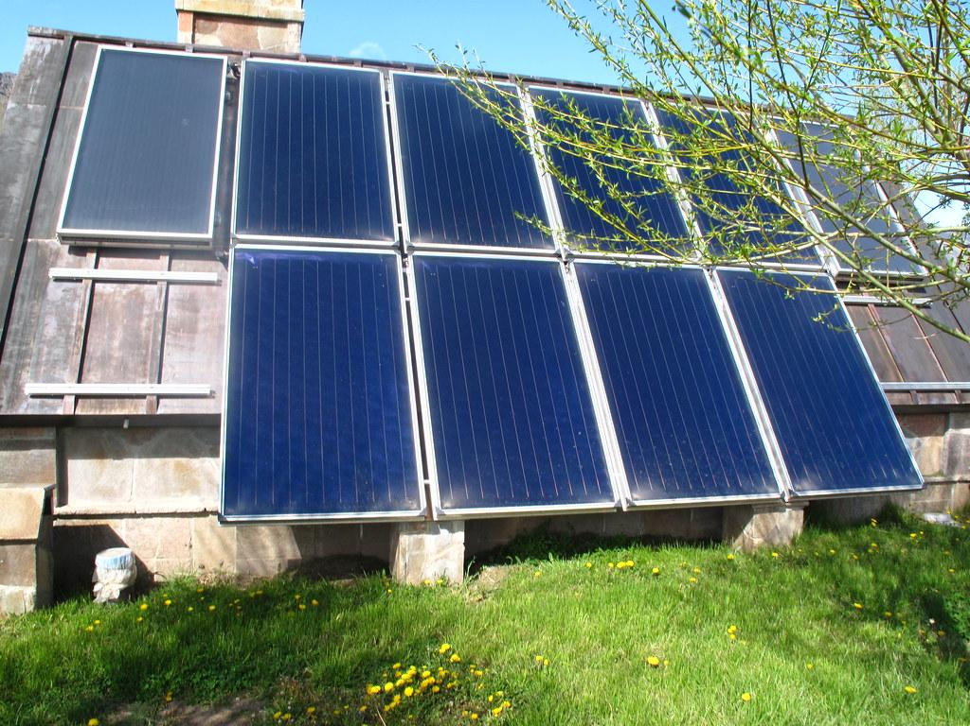
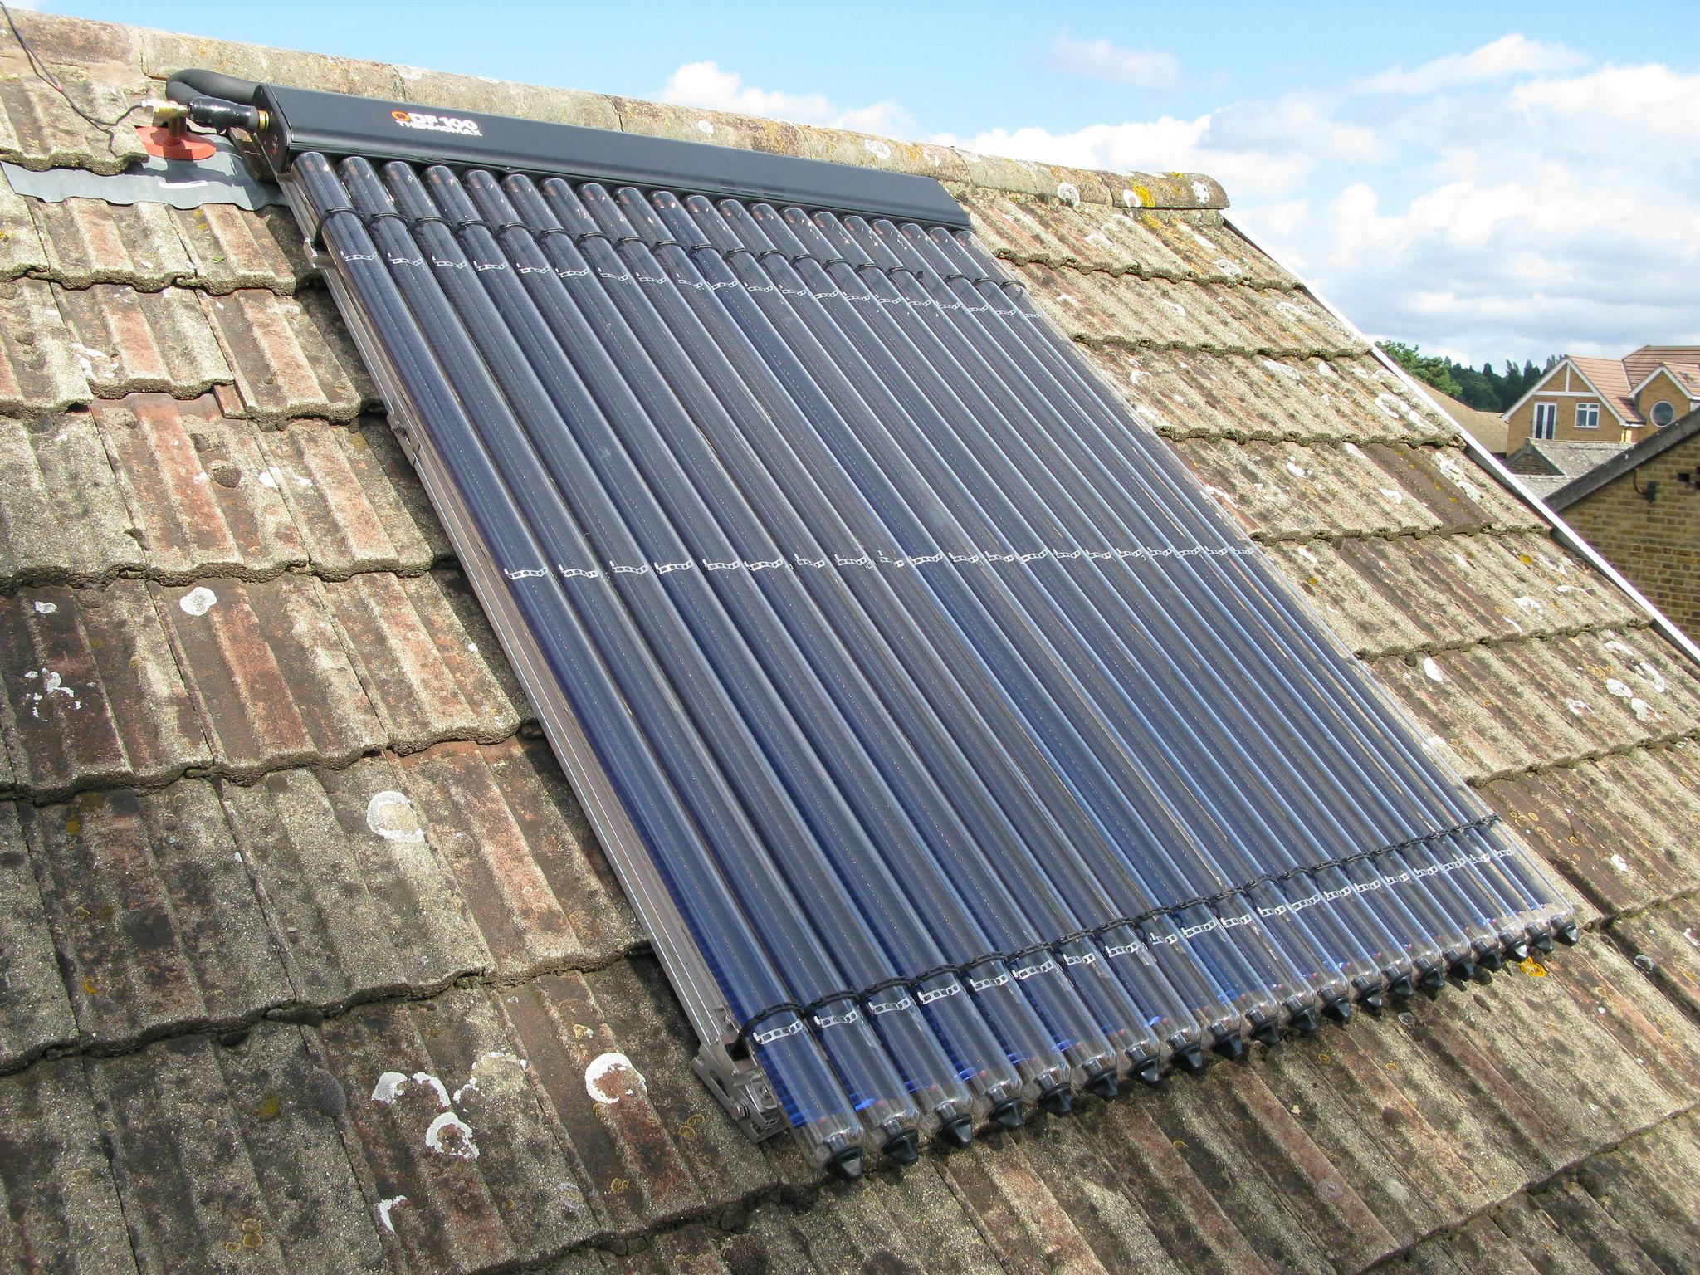
Low carbon heat -
solar thermal
Solar thermal (solar hot water)
Absorbs solar heat to pre-heat water for washing during daylight, including cloudy periods
Will meet around half of a household’s hot water needs over the year
Is rarely used for space heating in this country
Works with a hot water cylinder - if a combination boiler then cylinder will need to be added
Between October and March it’s best to use hot water later in the day to make the most of it
Less widespread in the UK than solar electricity
Where does your hot water come from? Dishwasher? Power shower? Or the boiler?
https://www.flickr.com/photos/a10/
https://www.flickr.com/photos/julianb/

Slide 25
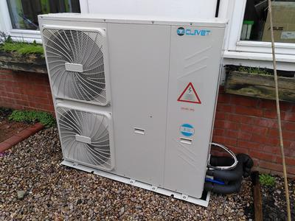
Low carbon heat - air source heat pumps
Like a fridge in reverse - transfers heat from one place to another
Uses electricity to pump heat from the air outside, into the home
Home needs to be well-insulated to at least the standards of the 2010 building regulations
Works best with under-floor heating but can work with radiators
Can provide hot water as well as space heating but a secondary appliance such as an immersion heater may be needed
Detailed financial appraisal necessary - an ASHP in the wrong home can be an expensive mistake

Slide 26
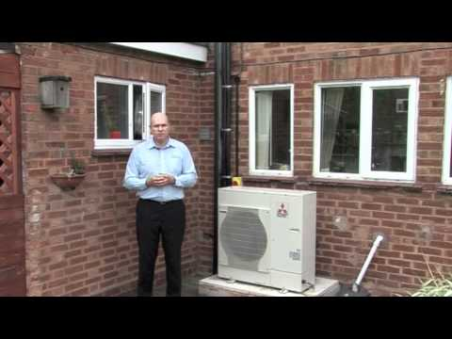
Air source heat pump - video
https://www.youtube.com/watch?v=HsFFJTB16N0
Notes:
https://www.youtube.com/watch?v=HsFFJTB16N0

Slide 27
Hybrid air source heat pumps
Recent addition to the Green Homes Grant
Two sources of heat - the heat pump; and your existing boiler (gas; LPG; kerosene heating oil)
Smart controls switch between the two sources of heat to minimise costs and CO2 emissions
Would cope better with spikes in heat demand e.g. very cold nights, to deliver a boost of heat
May have additional cost benefits for people on smart electricity tariffs - “agile” tariffs or “time of use” tariffs

Slide 28
Where air source heat pumps can go wrong
Not understanding the heat demand for the building - e.g. under-estimating.
Insufficient insulation of walls and roof
Immersion heater is used for domestic hot water (washing) and is not properly controlled
Design issues e.g. not having a buffer tank
ASHPs operate at lower temperature heat than a boiler; do not suit short bursts of on/off heat

Slide 29
Low carbon heat - ground source heat pumps
Like an ASHP, they transfer heat from one place to another, but more efficient - since the earth’s surface is a better heat store than the air
Use electricity to pump heat from just under the ground, into your home
Home needs to be well-insulated to at least the standards of the 2010 building regulations
Works best with under-floor heating but can work with radiators
Can provide hot water as well as space heating but a secondary appliance such as an immersion heater may be needed
Can provide cooling
Detailed financial appraisal necessary - a GSHP in the wrong home can be an expensive mistake
Like ASHPs, they are low carbon; not zero carbon unless electricity from a genuine renewable source

Slide 30
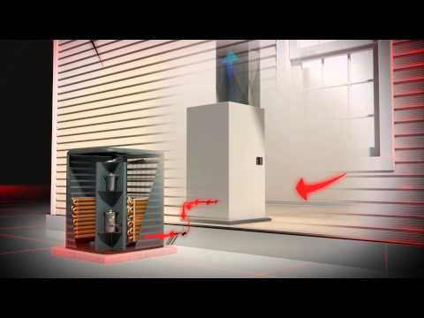
Ground source heat pump - videos
Notes:
https://www.youtube.com/watch?v=oCkeyZbkh5c​
https://www.youtube.com/watch?v=g39nM7GbSJA

Slide 31
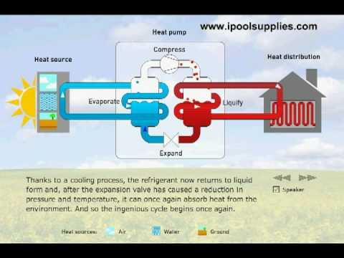
Ground source heat pump - videos
Notes:
https://www.youtube.com/watch?v=oCkeyZbkh5c​
https://www.youtube.com/watch?v=g39nM7GbSJA

Slide 32
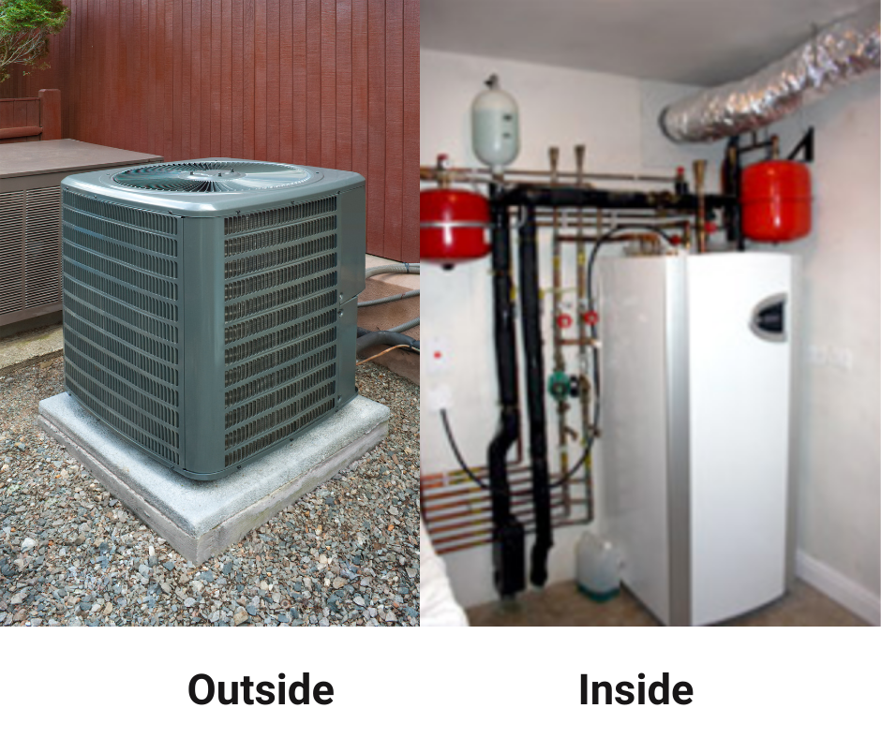
GSHPs
A slinky coil buried just under the surface of the ground absorbs heat all year round
You typically need three times as much ground space as the floor space of your home
Geological survey is necessary
GSHPs could be used for community or district heating systems, to heat a group of homes
You would need to set up an energy services cooperative to bill each household for metered heat delivered

Slide 33
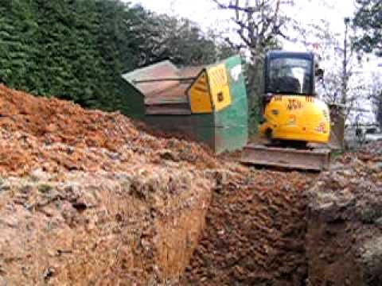
GSHPs

Slide 34
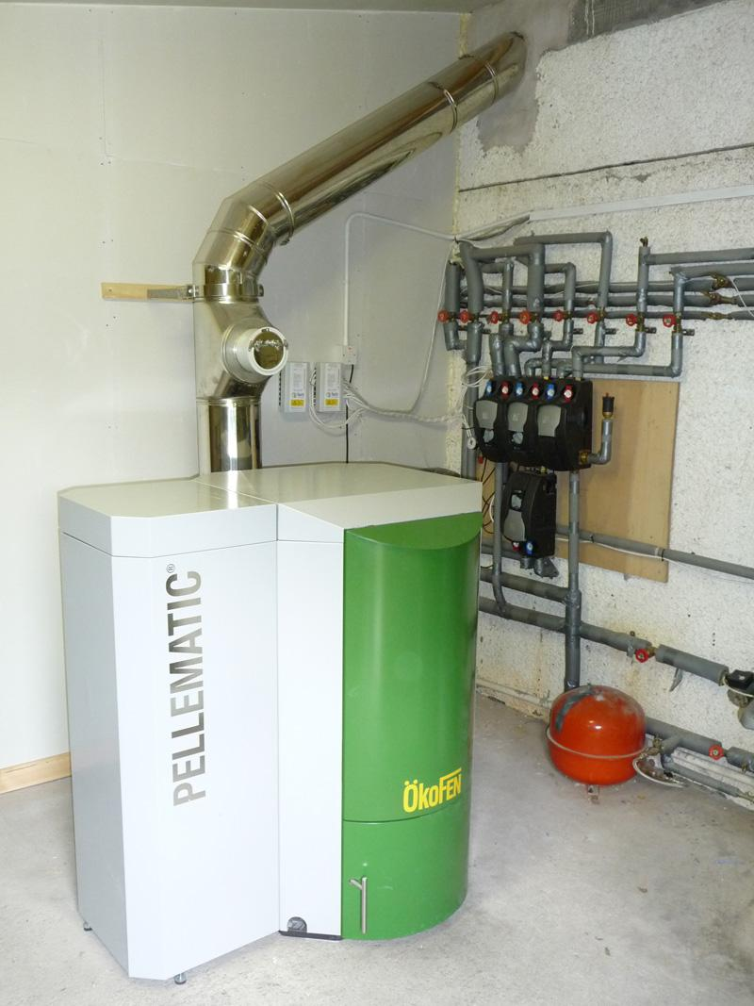
Wood pellet boilers - main considerations
Space for boiler and pellet storage
Compliance with clean air regulations by buying the right product and having it installed properly
Loading the boiler
Biomass is low carbon but not carbon neutral - emits a small amount of GHGs
Sustainability of fuel source
Photo credit Geneva2106 Wikipedia

Slide 35
Green Homes Grant - enabling measures
The Green Homes Grant will pay for most enabling works, such as:
Scaffolding
Redecorating
Repositioning of radiators, sockets, etc on internal wall insulation
Repositioning of cills, ventilation, external cabling, etc on external wall insulation

Slide 36
No insulation without ventilation
Adding insulation or glazing to older houses (especially mid 20thC or earlier) reduces the flow of air. This can make it more difficult for water vapour to be removed from the house.
Most homes now have inadequate ventilation, and it needs to be improved.
This can be passive ventilation - e.g. vents, air bricks - or mechanical ventilation
Mechanical ventilation with heat recovery - MVHR - look for experienced installers and be aware there are maintenance costs
Ventilation and draughts are not the same. Ventilation is a planned, controlled movement of air. Draughts are uncontrolled, unplanned movement of air.
Ventilation is not eligible for the Green Homes Grant. This is a mistake, in my view.
https://www.flickr.com/photos/julianb/

Slide 37

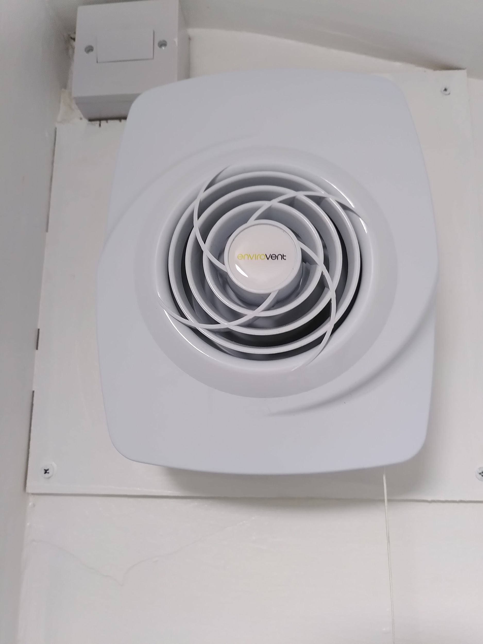
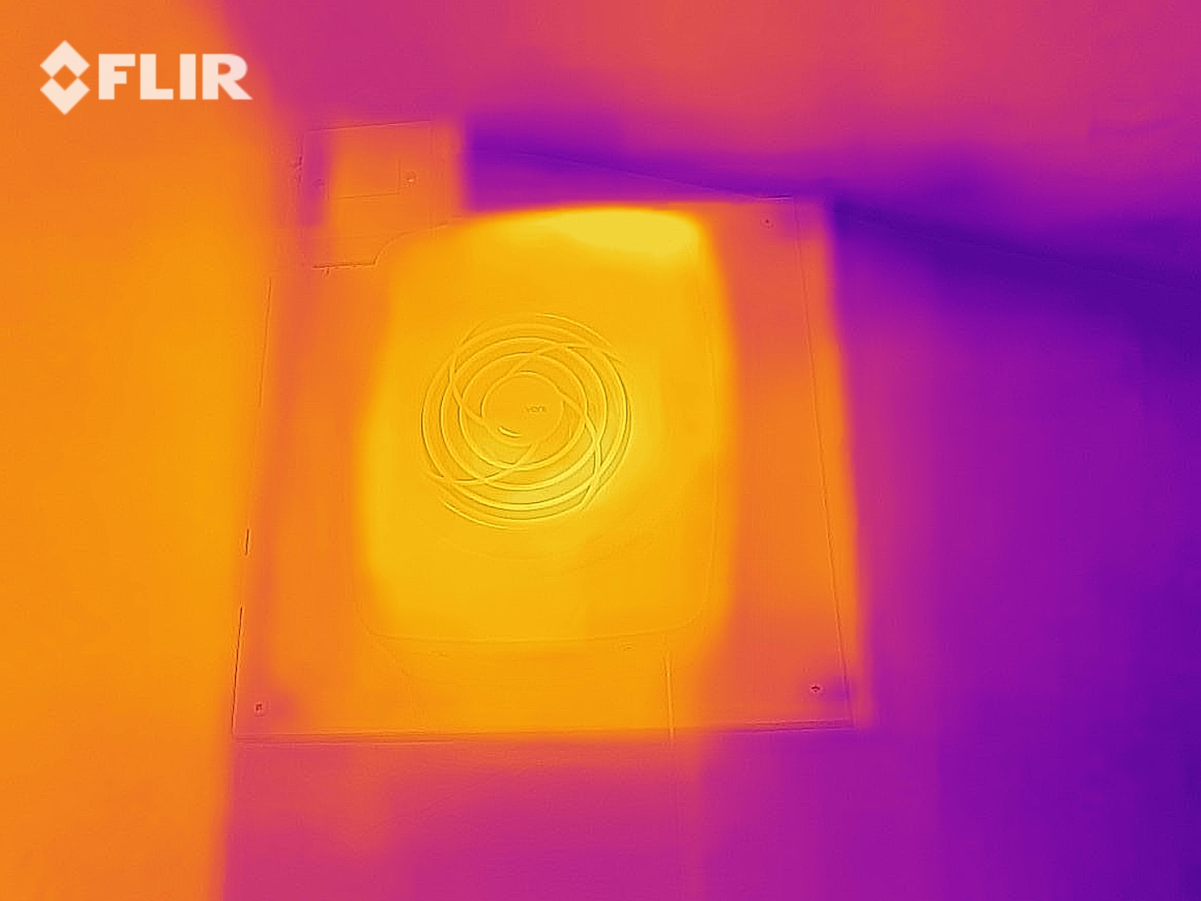
Air vent - heat loss
Extractor fan - heat loss
Low energy extractor fan
https://www.flickr.com/photos/julianb/

Slide 38
More on primary & secondary measures
So long as there is at least one primary measure in the package of works, households will also be able to install secondary measures.
Secondary measures can only be subsidised up to the amount of subsidy provided for primary measures. (e.g. if a household receives £1,000 for primary measures, they can only receive a maximum of £1,000 towards secondary measures).
You can’t use more than 50% of the grant on secondary measures, e.g. glazing
For low-carbon heating to be installed, households will need to have adequate insulation (e.g. wall and loft, where applicable).
These can be installed as part of a package – they do not have to already be in situ.
This is the energy saving hierarchy in action.
https://www.flickr.com/photos/julianb/

Slide 39
General eligibility - ownership and building type
All owner-occupied homes (including long-leaseholders, shared ownership)
Landlords of private rented sector domestic properties
Landlords of social sector domestic properties (including LA owned homes)
(the landlord applies, not the tenant).
Park home owners (for residential sites including Gypsy and Traveller sites)
New-build domestic properties (that have not yet been occupied), and non-domestic properties are not eligible.

Slide 40
How much is a voucher worth?
Households on low income - 100% grant up to £10,000
Everyone else - two-thirds grant funding up to a maximum of £5,000
England only
Vouchers will be issued from September 2020 - March 2021, first-come, first-served
There are separate grant schemes that social landlords, and local authorities can apply for
Local authorities can apply for funding for properties of any tenure
•

Slide 41
Eligibility - low income scheme
• Income based Jobseekers allowance (JSA) • Income based Employment & Support Allowance (ESA) • Income Support (IS) • Pension Guarantee Credit • Working Tax Credit (WTC) • Child Tax Credits (CTC) • Universal Credit (UC) • Disability Living Allowance (DLA) • Personal Independence Payment (PIP) • Attendance Allowance • Carer’s Allowance • Severe Disablement Allowance • Industrial Injuries Disablement Benefit • Contribution based Jobseekers allowance (JSA) • Contribution based Employment & Support Allowance (ESA) • Housing benefit
Owner-occupiers and park homes only. Rented properties do not qualify for the low income scheme
What you get - 100% funded measures up to £10,000

Slide 42
Register for vouchers here
https://greenhomesgrant.campaign.gov.uk/?utm_campaign=green_homes_grant_2021

Slide 43
What information you need to apply
Confirmation of ownership
Confirmation of benefits if applying for low-income scheme
Property type, and age (optional)
Personal information
Which measures; numbers (e.g. number of walls being insulated - square metres of loft insulation; number of heat pumps; cost of measure; installer; Installer’s Trustmark licence number; date of quote
Copy of quote; copies of additional quotes (optional)
Consent boxes
Additional information from landlords:
Landlords have to state their business model and company registration number if applicable
Landlords have to state the Energy Performance Certificate ratings
Landlords have to declare state aid, and any other funding

Slide 44
Renewable Heat Incentive
A government scheme where you get paid for each kiloWatt hour (kWh) of renewable heat you generate
Solar thermal, wood pellet boilers, air source heat pumps, hybrid air source heat pumps, ground source heat pumps all quality
RHI is means tested against your Green Homes Grant voucher
This means it probably won’t be worth it for air source heat pumps or solar thermal,, so don’t get too excited
Might be worth it for a Ground Source Heat Pump.
https://www.flickr.com/photos/julianb/

Slide 45
Planning issues
ASHP is usually permitted development as long as installed to proper standards (MCS), unless on a listed building or a conservation area
GSHP is usually permitted development; if a listed building or conservation area, you should contact your local council to check local requirements
Solar thermal is a permitted development. However, local conditions may apply, e.g. in Bournville.
https://www.flickr.com/photos/julianb/

Slide 46
Examples of how £5,000 might be spent
Estimates
https://www.flickr.com/photos/julianb/

Slide 47
Examples of how £5,000 might be spent - 1
3 bedroom semi-detached house using 12,000 kWh gas/heating oil and 4,000 kWh electricity per annum
Already has cavity wall and loft insulation
Measure 1 - 10 kW Air Source Heat Pump - £8,000
Total cost - £8,000
Green Homes Grant Voucher - £5,000
Householder contribution = £3,000
https://www.flickr.com/photos/julianb/

Slide 48
Examples of how £5,000 might be spent - 2
3 bedroom semi-detached house using 12,000 kWh gas/heating oil and 4,000 kWh electricity pa
Already has loft insulation but not Cavity Wall Insulation
Measure 1 - 10 kW Air Source Heat Pump - £8000
Measure 2 - Cavity Wall Insulation - £2,000
Total cost - £10,000
Green Homes Grant Voucher - £5,000
Householder contribution = £5,000
https://www.flickr.com/photos/julianb/

Slide 49
Examples of how £5,000 might be spent - 3
3 bedroom semi-detached house using 12,000 kWh gas/heating oil and 4,000 kWh electricity pa
Already has loft insulation but not Cavity Wall Insulation
Measure 1 - Solar thermal - £3,000
Measure 2 - Cavity Wall Insulation - £2,000
Total cost - £5,000
Green Homes Grant Voucher - £3,333 (two-thirds of total cost)
Householder contribution = £1,666
The householder also decides to install a mechanical ventilation system - cost £1,000 - but this is not funded by the Green Homes Grant as it is ineligible.
https://www.flickr.com/photos/julianb/

Slide 50
Examples of how £10,000 might be spent
Estimates
https://www.flickr.com/photos/julianb/

Slide 51
Examples of how £10,000 might be spent - 1
3 bedroom semi-detached house using 12,000 kWh gas/heating oil and 4,000 kWh electricity pa
Already has cavity wall and loft insulation
Measure 1 - 10 kW Air Source Heat Pump - £8,000
Total cost - £8,000
Green Homes Grant Voucher - £8,000
Householder contribution = £0
https://www.flickr.com/photos/julianb/

Slide 52
Examples of how £10,000 might be spent - 2
3 bedroom semi-detached house using 12,000 kWh gas/heating oil and 4,000 kWh electricity pa
Already has loft insulation but not Cavity Wall Insulation
Measure 1 - 10 kW Air Source Heat Pump - £8000
Measure 2 - Cavity Wall Insulation - £2,000
Total cost - £10,000
Green Homes Grant Voucher - £10,000
Householder contribution = £0
https://www.flickr.com/photos/julianb/

Slide 53
Examples of how £10,000 might be spent - 3
3 bedroom semi-detached house using 12,000 kWh gas/heating oil and 4,000 kWh electricity pa
Already has loft insulation but not Cavity Wall Insulation
Measure 1 - Solar thermal - £3,000
Measure 2 - Cavity Wall Insulation - £2,000
Total cost - £5,000
Green Homes Grant Voucher - £5,000
Householder contribution = £0
The householder also decides to install a mechanical ventilation system - cost £1,000 - but this is not funded by the Green Homes Grant as it is ineligible.
https://www.flickr.com/photos/julianb/

Slide 54
Examples of how £10,000 might be spent - 4
3 bedroom semi-detached house using 12,000 kWh gas/heating oil and 4,000 kWh electricity pa
Already has loft insulation and Cavity Wall Insulation
Measure 1 - Ground Source Heat Pump - £15,000
Total cost - £15,000
Green Homes Grant Voucher - £10,000
Householder contribution = £5,000
https://www.flickr.com/photos/julianb/

Slide 55
How an installer might exploit the £10k grant
3 bedroom semi-detached house using 12,000 kWh gas/heating oil and 4,000 kWh electricity pa
Already has loft insulation and cavity wall insulation
Measure 1 - 10 kW air source heat pump - £10,000
Measure 2 - heating controls - £1,200
Total cost - £11,200
Green Homes Grant Voucher - £10,000
Householder contribution = £1,200
https://www.flickr.com/photos/julianb/

Slide 56
How will I know if I am better off?
Measure your consumption of electricity for the last 12 months - in kiloWatt hours (kWh) - this should be on one of the bills you have received in the last 12 months
If you have a prepayment meter (for electricity or gas) you can get this by interrogating the meter - find out the make and model of the meter - Google the manual for your meter and find out how to do it - or ask your supplier. Do not use the amount spent in £ because this might include fuel debt
Measure your consumption of mains gas for the last 12 months - in kiloWatt hours (kWh) - this should be on one of the bills you have received in the last 12 months
Measure your consumption of heating oil / LPG for the last 12 months - in litres - then Google how to convert it to kWh
You now have baselines for electricity and heat consumption
Add up the total energy you have used for all fuels in kWh
Record the price you are paying in kWh / litres for each fuel
https://www.flickr.com/photos/julianb/

Slide 57
How will I know if I am better off?
After the work is complete
Monitor your use of mains gas, electricity, kerosene oil, LPG, wood pellets using a spreadsheet
If you are using wood pellets, Google the formula for converting kg or tonnes of wood pellet to kWh
After 12 months, work out whether the amount of kWh you have used has changed
Remember that if you have changed heating fuel (e.g. from gas to ASHP, or electric to wood pellet) then this will be reflected in your results
Record how much you are now paying per kWh / litre / tonne for each fuel - bear in mind prices will have gone up in the last 12 months
You should now have figures for energy savings (kWh) and cost savings
Remember to compare your cost savings to the amount
That you spent on the measures
https://www.flickr.com/photos/julianb/

Slide 58
Looking after wildlife
Wildlife can be displaced by external wall insulation, or replacing passive ventilation (air bricks) with mechanical ventilation
Species displaced include insects, spiders, birds, bats
Bird boxes, bat boxes, insect boxes are a simple and effective way to mitigate this.
Always buy products endorsed by a recognised wildlife charity and install in accordance with the instructions.
https://www.flickr.com/photos/julianb/

Slide 59
What to ask installers
“How did you size my heat pump? Can I see your calculations? What is my demand for space heating and hot water and how did you calculate it? How did you calculate the proposed running costs of the heat pump compared to my existing system?”
There should be a current baseline in kwh per annum, and a current running cost based on the price you actually pay per kWh or litre for your current fuel; a heat demand calculation based on your current consumption and confirmed by software; and a future running cost based on the expected electricity demand of the heat pump; and the actual price you pay in kWh for electricity. NO ESTIMATES
“How will my heat pump cope with spikes in heat demand? Will it have a buffer tank?”
Will you insulate my loft hatch? Will you insulate around the eaves of my loft?
What accreditations do you have?
What warranties does the product have?
How long has your company been trading for?
https://www.flickr.com/photos/julianb/

Slide 60
Low cost measures
Use your heating controls
LED light bulbs - including fluorescents, bulkheads
Draughtproofing any single glazed windows or doors, letterboxes, keyholes
Radiator shelves and reflective foil
https://www.flickr.com/photos/julianb/

Slide 61
Benefits of independent and impartial advice
A whole-house approach, not a piecemeal approach, is needed to approach zero carbon
Help to understand what measures are right for your home and your lifestyle
Understanding the savings you will achieve in £, and on your carbon footprint
Someone who will advise you not to do something that isn’t right for you
Help with choosing installers and understanding quotes
Helping you to work out how much you have saved in money and on your carbon footprint
Advising you on low-cost actions that you don’t need the Green Homes Grant for
Using thermal imaging to better understand heat loss from your home
Someone who acts in your best interests and is an advocate for you and your home
Helping you to find an installer if you want me to
10% off for webinar attendees - check your email
https://www.flickr.com/photos/julianb/

Slide 62

https://www.flickr.com/photos/julianb/

Slide 63
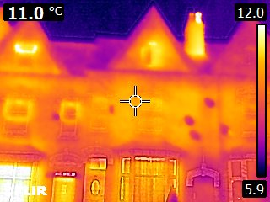
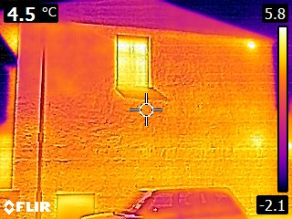
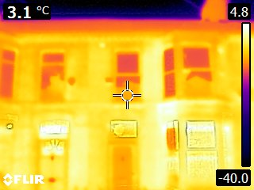
Thermal imaging season is here
https://www.flickr.com/photos/julianb/

Slide 64
Special offer - GHG group advice
a one-hour group coaching session for a group of up to 6 people – who could be neighbours, co-workers, friends – on Zoom
follow-up written reports for each participant.
£299 - book by 30 November 2020.
https://energyconfidence.co.uk/product/green-homes-grant-group-advice/

Slide 65
Questions?

Slide 66
Thank you for attending
www.energyconfidence.co.uk/

Slide 67
Possible questions
Fuel poverty
PV
Existing PV with batteries
Alternative insulation materials

